Slide 1
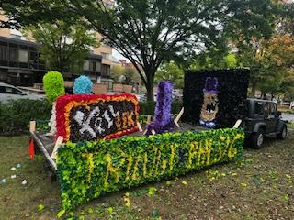
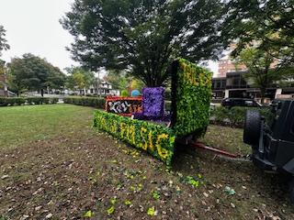
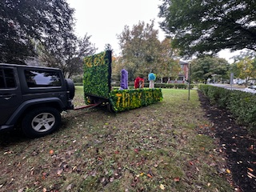
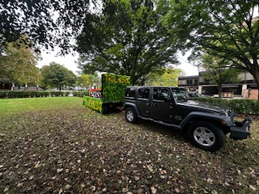
2024
Annual Meeting

Slide 2
Meeting Agenda
Introductions – Alumni Board, Actives Executive Board
General Membership Election - Board Members, Officers
State of Actives – Evan Lipp, President
State of Brotherhood
David Hyland, Chair – House Committee
Ben Jarmul – Treasurer
Martin Barbato – President
Capital Campaign Update
House Tour – the Actives
Q&A
Adjourn

Slide 3
Alumni Board Members and Officers
Board Members
Bill Albertson (1973)
Steve Handwerk (1974)
Martin Barbato (1979)
James Durfee (1980)
David Hyland (1980)
Ben Jarmul (1981)
Matt Rose (1986)
Joe Mazziotti (2014)
Nick Sandford (2016)
Advisors to the Board
Fred DeCock (1980)
Dan Lourie (2014)
Regis Capoferri (2022)
Chapter Advisor – Mark Robinson (1985))

Slide 4
Actives Executive Board & Other Leaders
President - Evan Lipp
Vice President- Colin Howe
Treasurer- Christopher Seelig
Secretary- Eric Coyle
Inductor- Ryan Kirby
Sentinel- Marko Kosanovich
Alumni Relations - Jasper Abraham
House Manager- Carmen Panuccio

Slide 5
General Membership Elections
Members up for vote (3-year terms)
Martin Barbato
James Durfee
Joseph Mazziotti
Officers (1-year terms)
Martin Barbato – President
David Hyland – Vice President
Ben Jarmul – Treasurer
Joe Mazziotti – Secretary
Additional Nominations?

Slide 6
State of Actives
By the Numbers
Total Actives - 34
In-house Actives - 23
no freshman rush in the Fall
Pledge Class of 17
Have 18 PNM’s for Spring 25
Action Plan on Verge of completion
THON
Thon Chairs working hard to get the ball rolling
Many events scheduled for this semester
Philanthropy
Breast Cancer Awareness
Raised nearly $1000
Donor Drive
https://donate.thon.org/?fuseaction=donorDrive.event&eventID=4104

Slide 7
Conduct Requirements

Slide 8
HQ Observations

Slide 9
Treasurer’s Report - Year Ended 7/31/24
Results of Operations
Housing operations surplus - $12,500
Alumni communications and fundraising surplus - $40,700
Surpluses required for capital projects
Expenditures for Capital Projects
Patio - $44,000
HVAC in basement - $19,500, HVAC on rooftop - $6,250
Financial Position
Cash on hand - $162,300
No debt - the mortgage was paid in full in November 2023

Slide 10
House Commitee
State of the House
House is in good shape - Nittany Co-op continues weekly inspections and facilitates repairs.
Very productive work weekend- August 2-4
19 actives and 13 alumni. Thank you all who participated!
Capital Projects
HVAC units installed in basement and on the rooftop
Outdoor patio is substantially completed
New rugs purchased for the foyer and living room
Replacement of flooring for 2nd and 3rd floor halls scheduled for the summer of 2025
Have initiated new house cleaning protocols with the actives with support from contract cleaner

Slide 11
Board Chair Report
State of the Alumni – By the Numbers
Total of 1,037 Living Alumni.
Have valid email for 550 (53%), regular mail addresses for 724 (70%).
Have valid cell phone numbers for 825 (79%).
Please ensure your information is current.
Please help with missing brothers.
Help Us All Stay Connected
Get your current address information to Emily Wanner at: eoneill@elevateims.com
Keep your Alumni Profile current.
Send notices of life changes (e.g., family, professional) to Emily.
Opt in to accept text messaging from PSK/Elevate
Website Portal: www.PhiSigPSU.com
Future Events/Celebration
100 years of Kappa Mansion – February 21, 2027

Slide 12
Capital Campaign Update
As of September 21st 2024:
$258,922.60 in pledges & contribution!
$105,645.90 balance due
97 Brothers Contributed
Let’s Break 100!
Key Moments in 2024:
Outdoor Patio completed
Crest Installed
Launch of Pledge Challenge
What Remains?
Looking for Brothers to step up for our pledge challenge!
Final Project is the Kitchen
Donors from last campaign who have not contributed to Damn Proud Campaign

Slide 13
Capital Campaign Update
We will reach out to Brothers from the list provided by Elevate IMS for our challenge match for those who have yet to contribute
Challenge matches include donations of 10k, 5k, and 2500k
Other Projects in motion include:
Live Feed of Kappa Chapter to strengthen Active/Alumni Relations
Digitization of Composites
Upgrade Kitchen
Our Ask:
Talk to your brothers from your class - check in as a friend, discuss the recent game, get their feedback on the campaign!

Slide 14
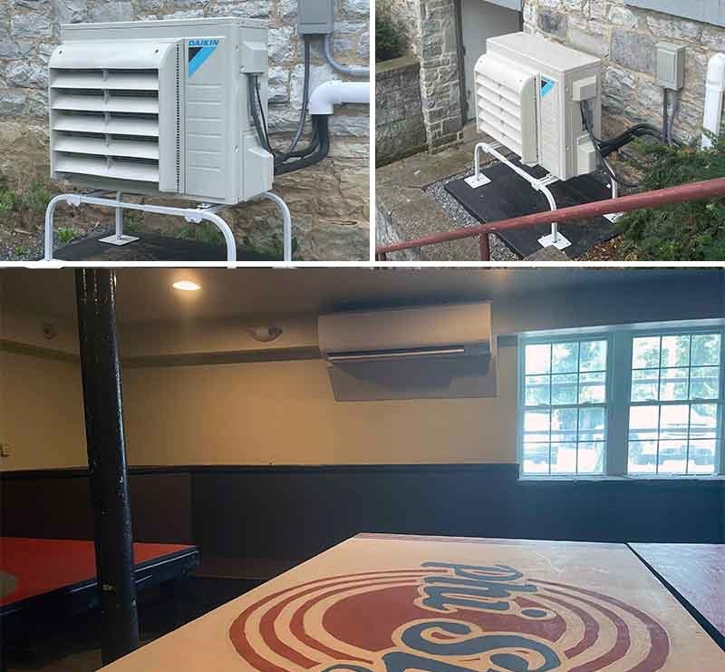
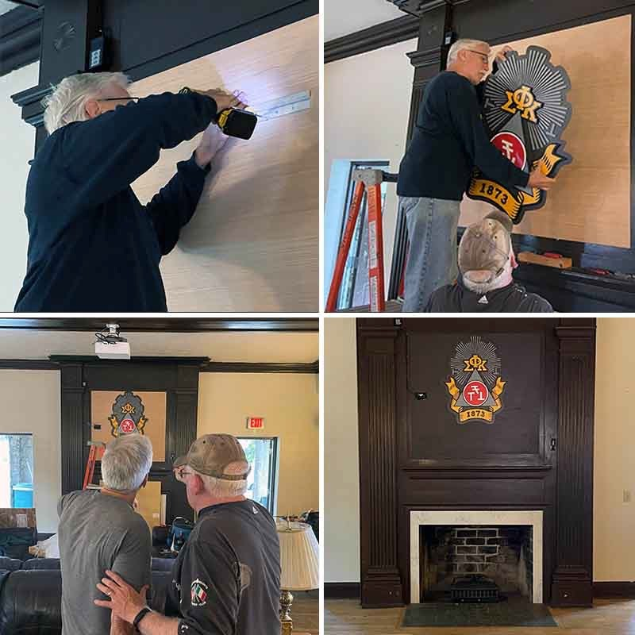
Completed Projects
Living Room Crest & Projector
Basement Air Conditioning

Slide 15
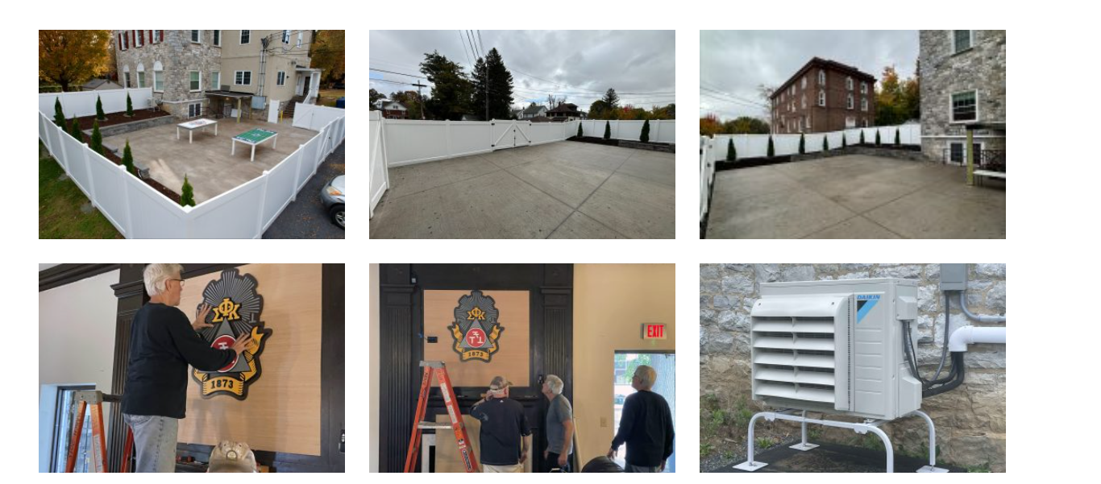
Outdoor Space & Crest

Slide 16
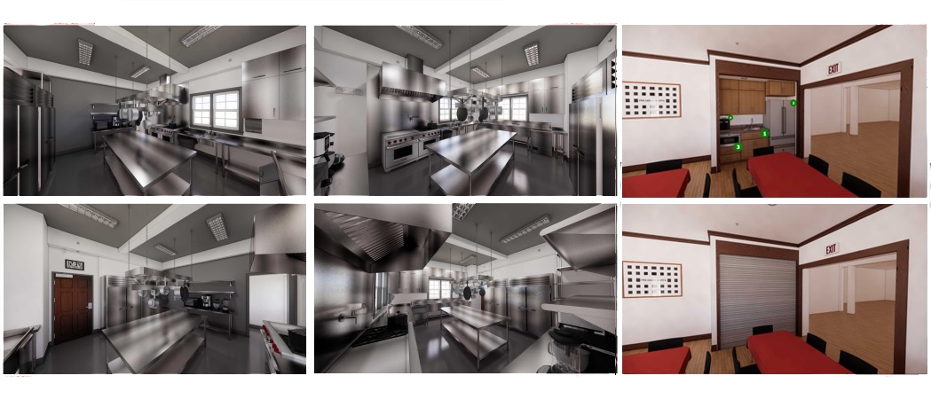
Kitchen Project: Requires Additional Support

Slide 17
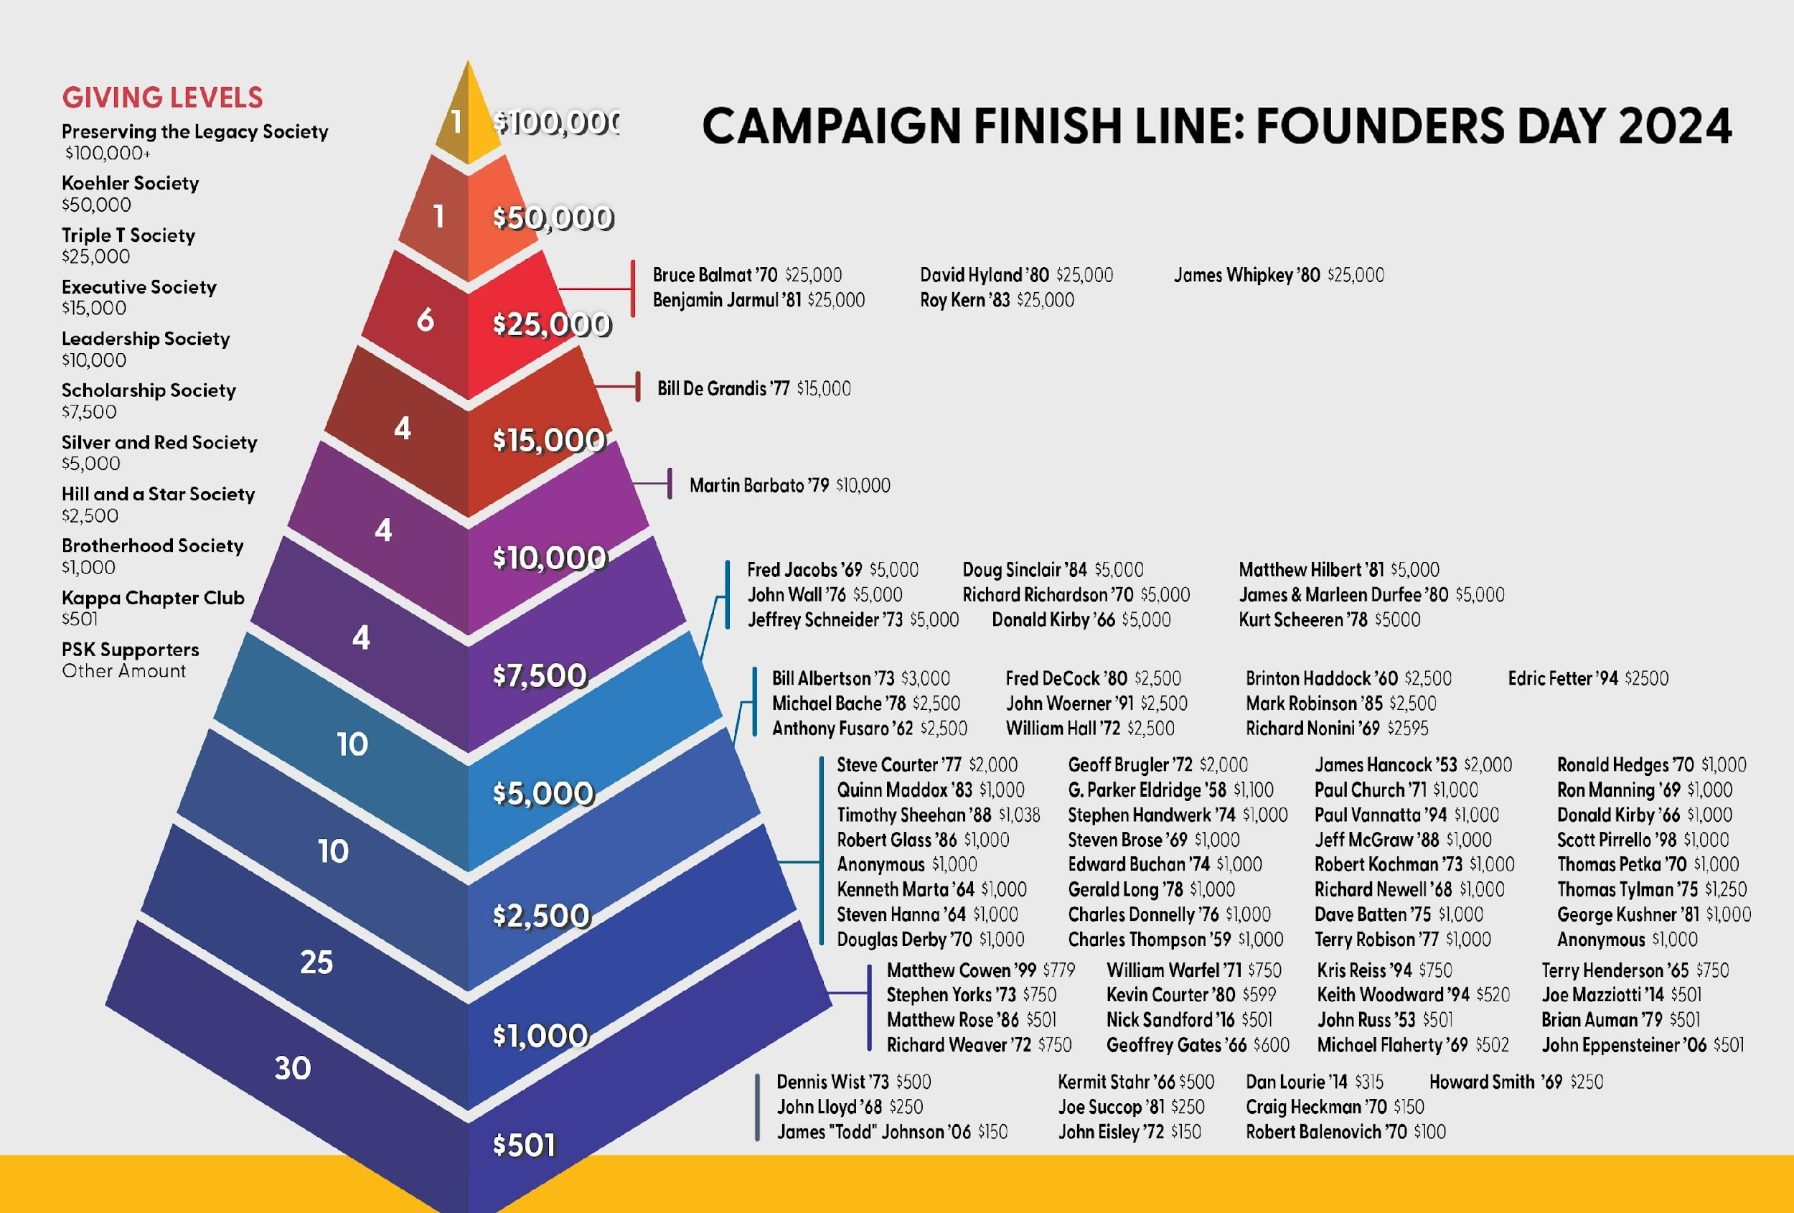
THANK YOU to our Damn Proud Supporters!

Slide 18
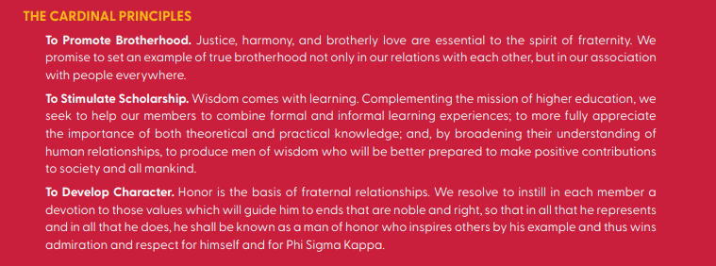
Capital Campaign Update
Thank You to Our Brothers!
To all the brothers who have pledged and donated to the Damn Proud Campaign, we extend our deepest gratitude. Your generosity is a testament to the enduring strength of our brotherhood and our shared commitment to preserving the legacy of Phi Sigma Kappa.
We are also proud to announce that we achieved 100% participation from our Board, showing our collective determination to strengthen our fraternity for all current and future brothers. Together, we are building a better future for Phi Sigma Kappa – one that honors our past, supports our present, and empowers the generations to come.
Thank you for being a vital part of this journey and for helping us achieve our shared vision for a brighter tomorrow. We couldn’t do it without you!
-Daniel Lourie, 2014

Slide 19
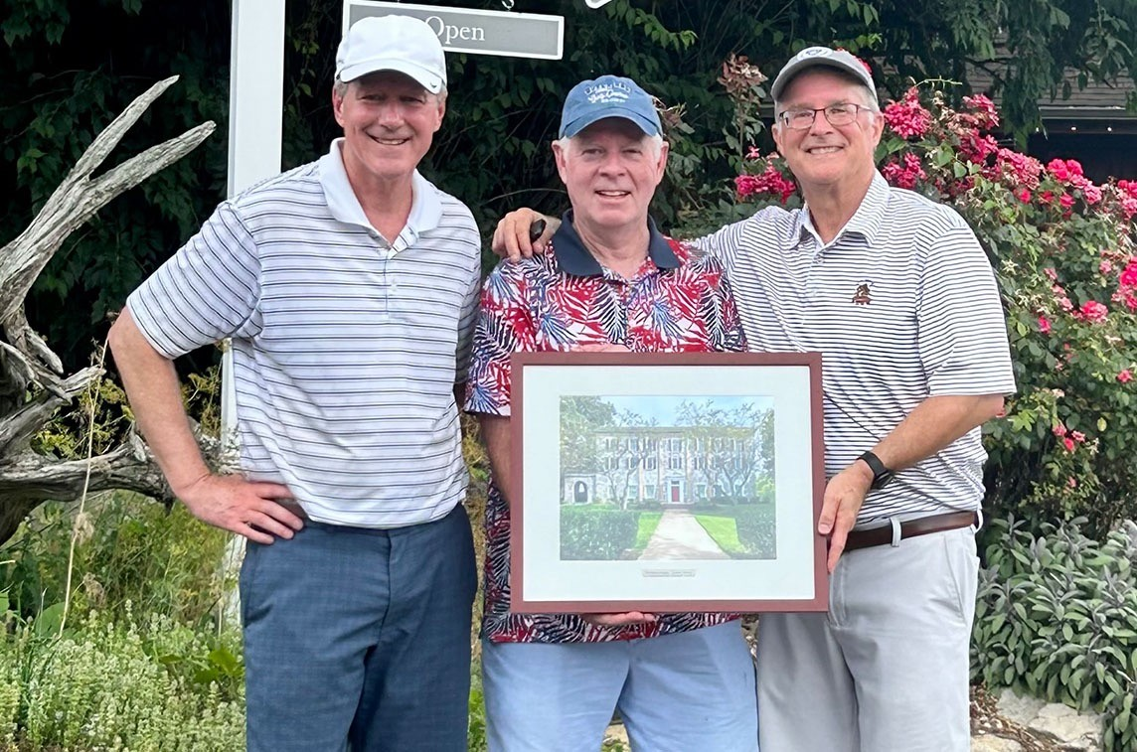
Please consider supporting the campaign
Pledges payable over 5 years
Every donor receives a beautiful framed lithograph of the House
PhiSigPSU.com/campaign

Slide 20
HOUSE TOUR

Slide 21
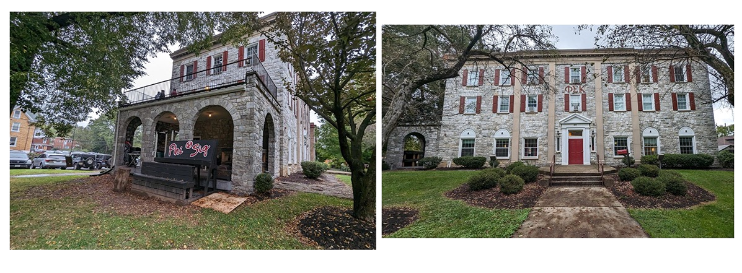
House Tour: Exterior

Slide 22
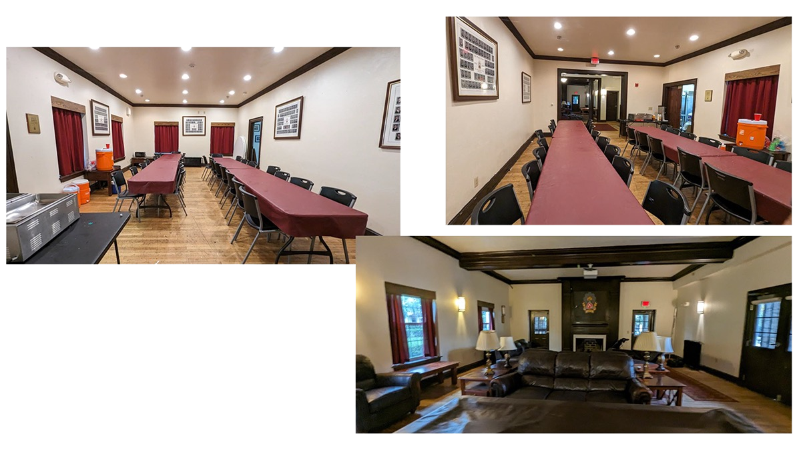
House Tour: First Floor

Slide 23
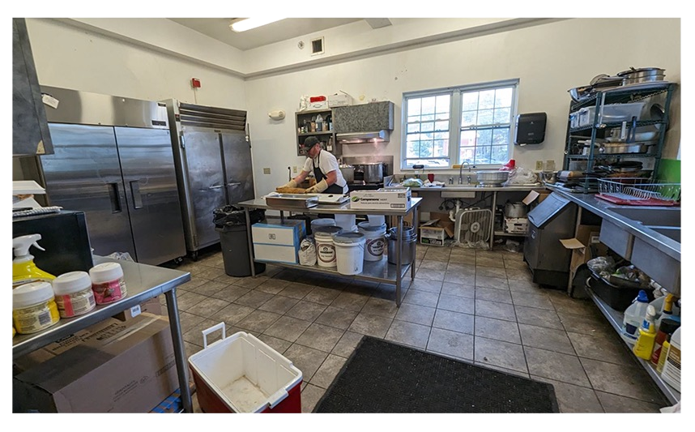
House Tour: Kitchen

Slide 24
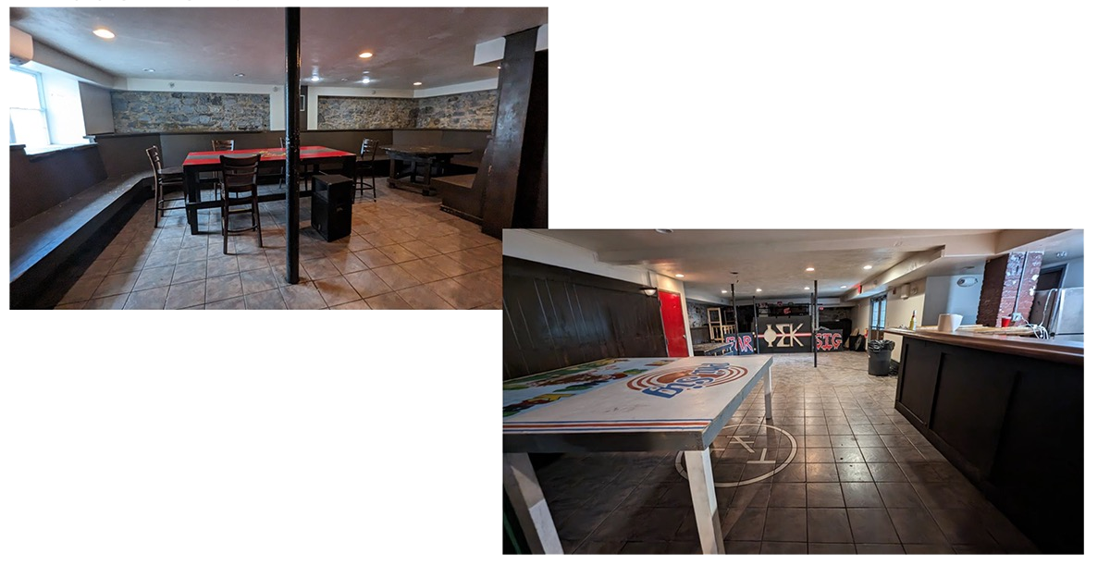
House Tour: Basement

Slide 25
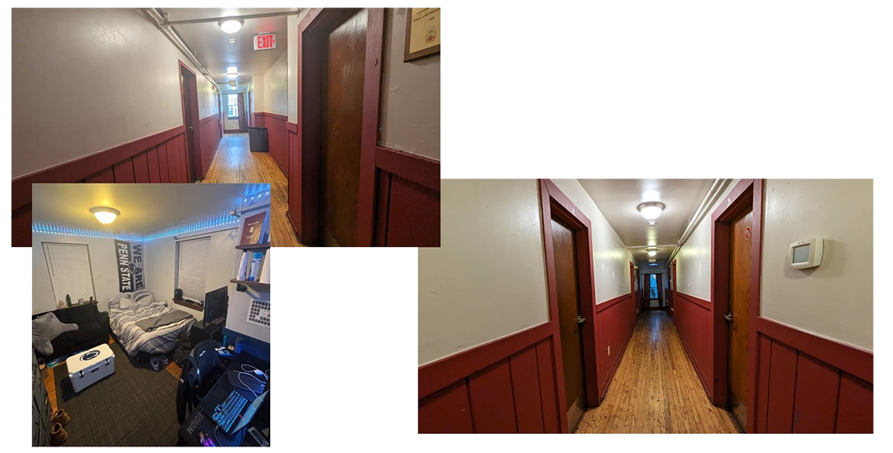
House Tour: 2nd & 3rd Floors

Slide 26
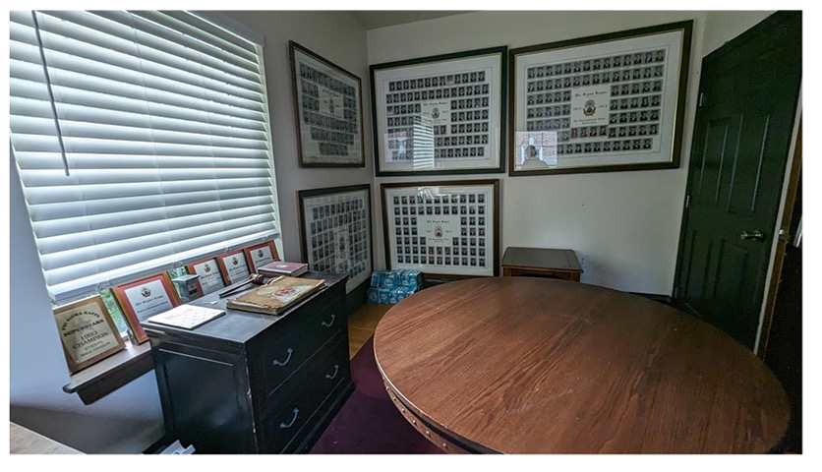
House Tour: Alumni Room

Slide 27
House Tour: Outdoor Space & Crest!

Slide 28
Q & A
Q&A
Adjourn

