Slide 1
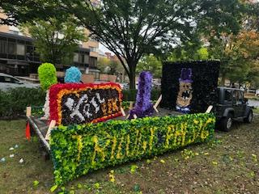
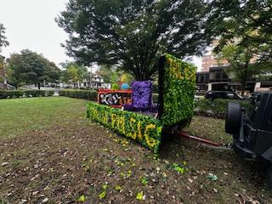

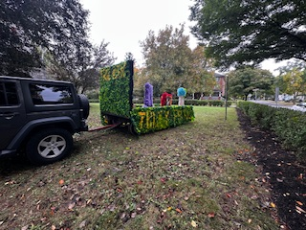
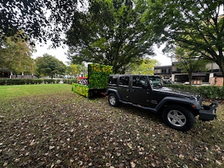
2025
Annual Meeting

Slide 2
Meeting Agenda
Introductions – Alumni Board, Actives Executive Board
General Membership Election - Board Members, Officers
State of Actives – Evan Scarton, President
State of Brotherhood
David Hyland, Chair – House Committee
Ben Jarmul – Treasurer
Martin Barbato – President
Capital Campaign Update
House Tour – the Actives
Q&A
Adjourn

Slide 3
Alumni Board Members & Officers
Board Members
Bill Albertson (1973)
Steve Handwerk (1974)
Martin Barbato (1979)
James Durfee (1980)
David Hyland (1980)
Ben Jarmul (1981)
Matt Rose (1986)
Joe Mazziotti (2014)
Nick Sandford (2016)
Advisors to the Board
Fred DeCock (1980)
Dan Lourie (2014)
Regis Capoferri (2022)
Chapter Advisor – Mark Robinson (1985))

Slide 4
Actives Executive Board & Other Leaders
President - Evan Scarton
Vice President-Luca Mastroberardino
Treasurer- Ethan Schlatner
Secretary- Thomas McCue
Inductor- Sean Reed
Sentinel- Evan Pennock
Alumni Relations – Jasper Abrahams
House Manager- Shaun Whistler

Slide 5
General Membership Elections
Members up for vote (3-year terms)
Bill Albertson
Nick Sanford
Dan Lourie (for David Hyland’s seat)
Officers (1-year terms)
Martin Barbato – President
Matt Rose – Vice President
Ben Jarmul – Treasurer
Joe Mazziotti – Secretary
New Advisers – Peter Spiotta (‘20), Bruce McKinney (‘78), Ron Manning (‘69)
Additional Nominations?

Slide 6
State of Actives
By the Numbers
Total Actives - 39
In-house Actives - 18
No freshman rush in the Fall
Pledge Class of 8
Action Plan on Verge of completion
THON
Thon Chairs working hard to get the ball rolling
Many events scheduled for this semester
Top 10 in Greek Orgs for Money Raised Last THON
Philanthropy
Breast Cancer Awareness
Raised nearly $1000
Donor Drive
https://donate.thon.org/events/4343

Slide 7
Treasurer’s Report - Year Ended 7/31/25
Results of Operations
Housing operations - $(29,600)
Alumni communications - $6,500
Fundraising - $60,000
Expenditures for Capital Projects
Total - $20,700
Patio, HVAC, technology, kitchen
Financial Position
Cash on hand - $$278,300
No debt - the mortgage was paid in full in November 2023

Slide 8
House Committee Report
State of the House
House is in good shape - Nittany Co-op continues weekly inspections and facilitates repairs.
General operating systems functioning well.
Capital Projects
Installed new video surveilance security system.
Installed new electronic door locks
Replacement of flooring for 2nd and 3rd floor halls scheduled for the summer of 2026
Received scaled down quote for kitchen. Includes new range, deep fryer, hood with fire suppression system, and make up air unit.

Slide 9
President’s Report
State of the Alumni – By the Numbers
Total of 1,017 living alumni
Have valid email for 469 alumni , regular mail addresses for 728 alumni.
Have valid cell phone numbers for 672 alumni.
Please ensure your information is current.
Please help with missing brothers.
Help Us All Stay Connected
Get your current address information to Emily Wanner at: eoneill@elevateims.com
Keep your Alumni Profile current.
Send notices of life changes (e.g., family, professional) to Emily.
Opt in to accept text messaging from PSK/Elevate
Website Portal: www.PhiSigPSU.com
Future Events/Celebration
100 years of Kappa Mansion – February 21, 2027

Slide 10
President’s Report: Towards Turnkey Operations
President’s Report at Founders Day 2025
Background
Active enters Lease Agreement or Outside Active Agreement for the full academic year.
Active can be released from his agreement for an internship abroad or hardship.
Rent and Outside Active Fees are set to cover house ownership and operation costs.
Rent and Outside Active Fees are driven by the number of Actives living in the house; as the number goes down, the Rent and/or Outside Active Fee goes up.
Chapter Dues are set to cover Actives operating costs (e.g., National, Social, Utilities). Meal plan is set by the vendor.
Payment is to be made by the beginning of the semester.
Issue: Managing the contract and Payment processes.

Slide 11
President’s Report: Towards Turnkey Operations
Activity Since Founders Day 2025
Installed digital locking doors on exterior doors with access codes to control entry.
Reinstated our former Nittany Co-op room access process.
Active presented a copy of 1) Signed Lease or Signed Outside Active Agreement, 2) Signed Parental Guarantee, and 3) Proof of payment for the semester or proof of an approved payment plan.
Nittany issued an access card.
Board is investigating a property management firm.

Slide 12
President’s Report: Looking to the Future
President’s Report at Founders Day 2025
Problems to Address
Fighting trend of anti-fraternity sentiment.
New Actives have different challenges and different goals.
Pledging – a lost history, a lost connection, and a lost value.
Need to redefine the threads that bind us, i.e., that bind middle-aged Alumni, retirement-age Alumni, undergrad Actives.
Very competitive race for potential new members.
Piazza Agreement

Slide 13
President’s Report: Looking to the Future
President’s Report at Founders Day 2025
Path Forward – Inputs, Analysis, and Goal
Inputs
Value Proposition for Actives – per survey, desire help from Alumni.
Value Proposition for Alumni – surveyed but updated survey coming; assume, at a minimum, that Alumni want Kappa’s Mansion preserved.
Analysis
Actives and Alumni are dependent upon each other.
Actives provide financial support for annual operations.
To attract Actives, Actives seek Alumni for post-undergraduate support.
To maintain the house and the memory of it (which will fade with the loss of the physical house), Alumni need new Brothers.
“Actives take care of the house, and Alumni take care of the Actives”.
Goal – make PSK-Kappa attractive to new Actives. To do so, need a Brand.

Slide 14
President’s Report: Looking to the Future
President’s Report at Founders Day 2025
Brand – what should be PSK’s Brand?
Proposal
Commitment to Goals to Self and beyond Self – Cardinal Principles.
Networking - for post-PSU employment and/or graduate education.
Opportunities for Learning – in Leadership and in Community Involvement.
Quality Lifestyle Experience - competitive room & board cost, shared with friends, in an unparalleled physical setting.
Lifetime intangibles and tangibles - friendships, community, and the physical house.
Will survey Alumni for input.

Slide 15
President’s Report: Looking to the Future
President’s Report at Founders Day 2025
Goal for Fall 2025 (in time for August 1, 2025)
Brand documentation ready for Fall ’25 rush.
Actives and Alumni interdependent relationship in place. Requires Elevate website updates and Alumni profiles updated.
Looking for volunteers to jump in immediately, with a goal of implementation by August 1, 2025.
Future Projects
Wall of Honor
Future value
Enable Board to change focus from 80% house and finances and 20% brotherhood, to 80% brotherhood and 20% house and finances.
Getting ready for future Board Members and Officers.
Generate interest in Alumni to volunteer, for Board involvement or for Special Projects.

Slide 16
President’s Report: Looking to the Future
Activity Since Founders Day 2025
Have input from Actives from F’24. Need a regular input system (e.g., beginning of every fall semester).
Still working:
Alumni Involvement.
Alumni Survey Input
Brand Documentation.
Elevate website updated.
Alumni profiles updated.
Future Project - Wall of Honor
Continue to get to turnkey, so next President and Board can focus on value proposition, for recruitment, Actives, and Alumni.

Slide 17
President’s Report: New Special Committees
Problem Addressed:
PSK’s value proposition is impacted greatly by two things:
Alumni-Active relationships through mentoring and networking.
The condition of the physical house.
Too much work for the Board alone to do.
Article X, Section 2: The Board may delegate powers to standing or special committees
Proposal: Create Special Committees
Alumni-Active Committee
Single focus: Connections between Alumni and Actives for Mentoring.
Why? To positively impact recruitment.
Initial Project: Elevate website improvements. Create a PSK LinkedIn on the Elevate Website. Add a Help Wanted general mailbox. Encourage alumni to create profiles. May require investment, which could lead to licensing revenue opportunity.
Capital Investment Plan Advisory Committee
[insert from Ron Manning notes]
Historical Preservation Committee
Digitization of Records and Composites.
Alumni Accomplishments and Chapter Eternal. Getting information onto Elevate website. Explore auto feed from Penn Stater.
Opportunity for Alumni to Volunteer

Slide 18

ALUMNI-ACTIVES COMMITTEE
We have introduced an email dropbox for the actives to request help with:
Networking
Resume review
Job/Internship search
Getting connected to alumni in your desired field/industry
This will be integrated into the website in the future for more visibility
Getting setup to the PSK member portal
I will share a link with Eboard where you can sign up and get access to the directory of alumni - Barcode on next slide

Slide 19
Capital Campaign Update
As of October 10, 2025:
Total pledged and/or donated: $261,640!
$211,595 received
$50,049 pledge balance expected:
$16,497 current on pledge
$26,235 not current on pledge
$7,317 no payment received
The keystone project: Kitchen.
Revised estimate: $70k (special thanks to Geoff Brugler!) The revised project provides comparable benefits but with considerably less expense.
Bigger Takeaway:
With pledges completed, it would not be a problem to afford this project.
Even with just cash on hand, it can be justified
Looking for Brothers to step up for our pledge challenge!
Donors from last campaign who have not contributed to Damn Proud Campaign

Slide 20
Capital Campaign Update
Reach out to Alumni who are on payment plan and need to catch up
Contact alumni who pledged but did not pay (possible additional giving opportunity)
Continue to drive the last momentum of campaign as we wrap up 2025!
Our Ask:
Talk to your brothers from your class - check in as a friend, discuss the recent game, get their feedback on the campaign!

Slide 21
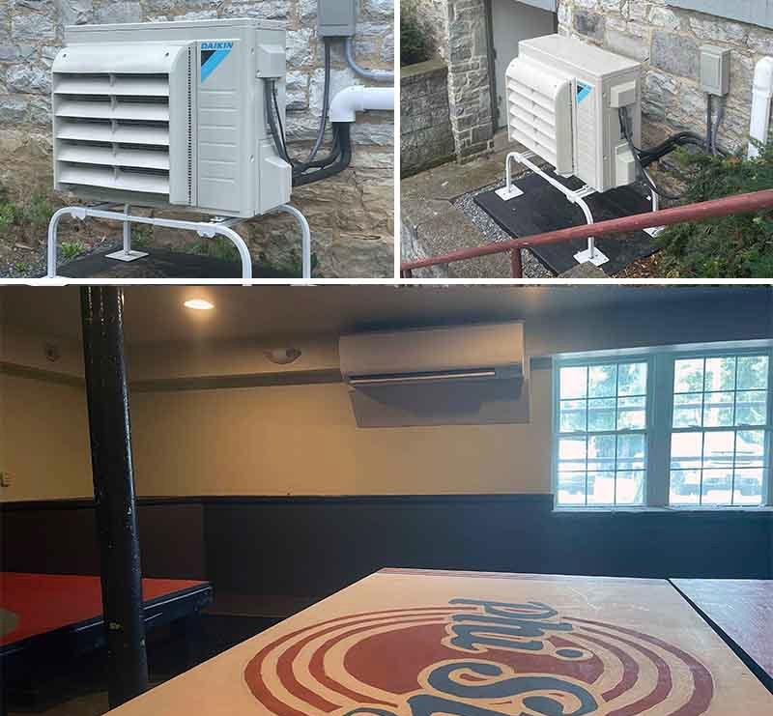
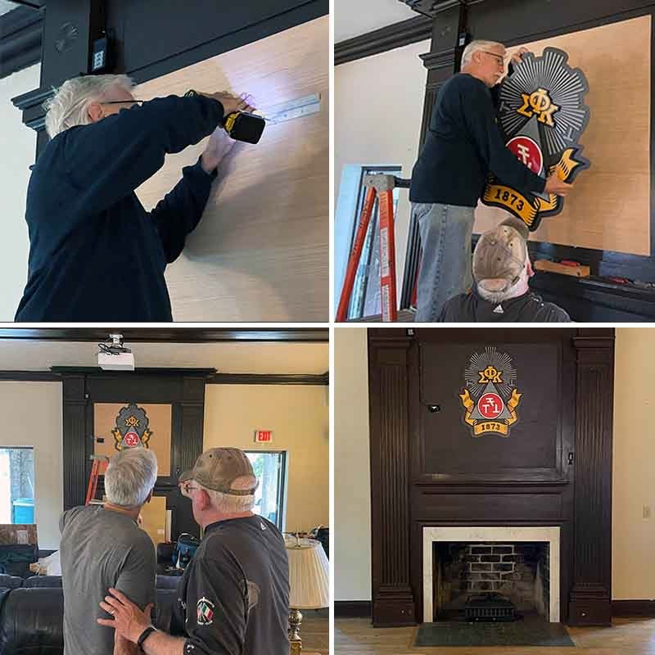
Completed Projects
Living Room Crest & Projector
Basement Air Conditioning

Slide 22
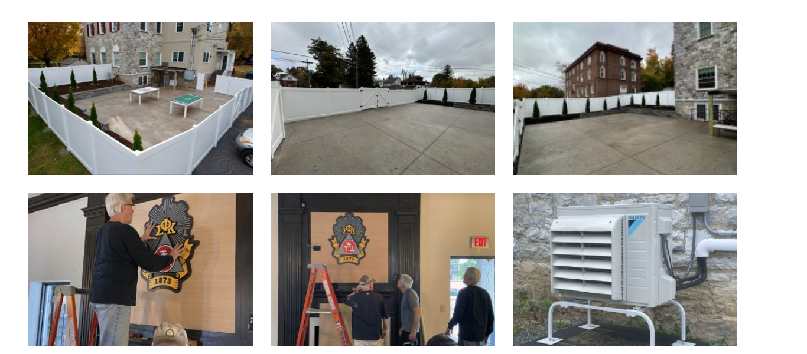
Outdoor Space & Crest

Slide 23
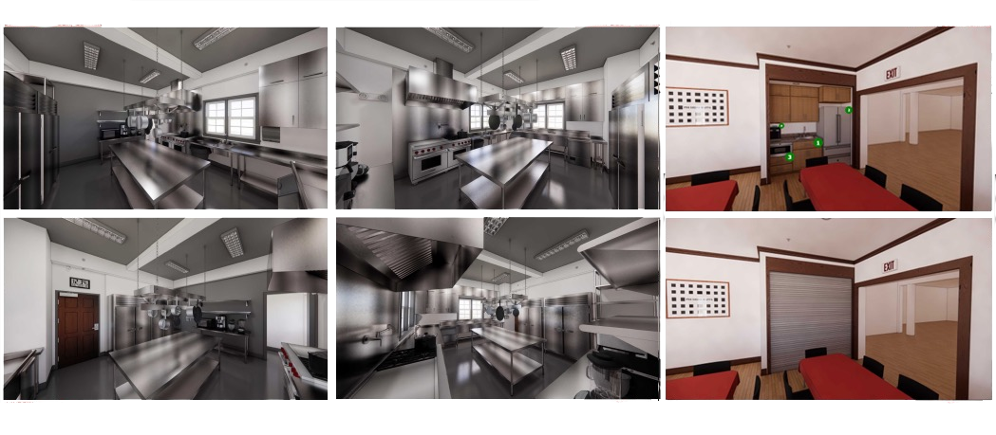
Kitchen Project: Requires Additional Support

Slide 24
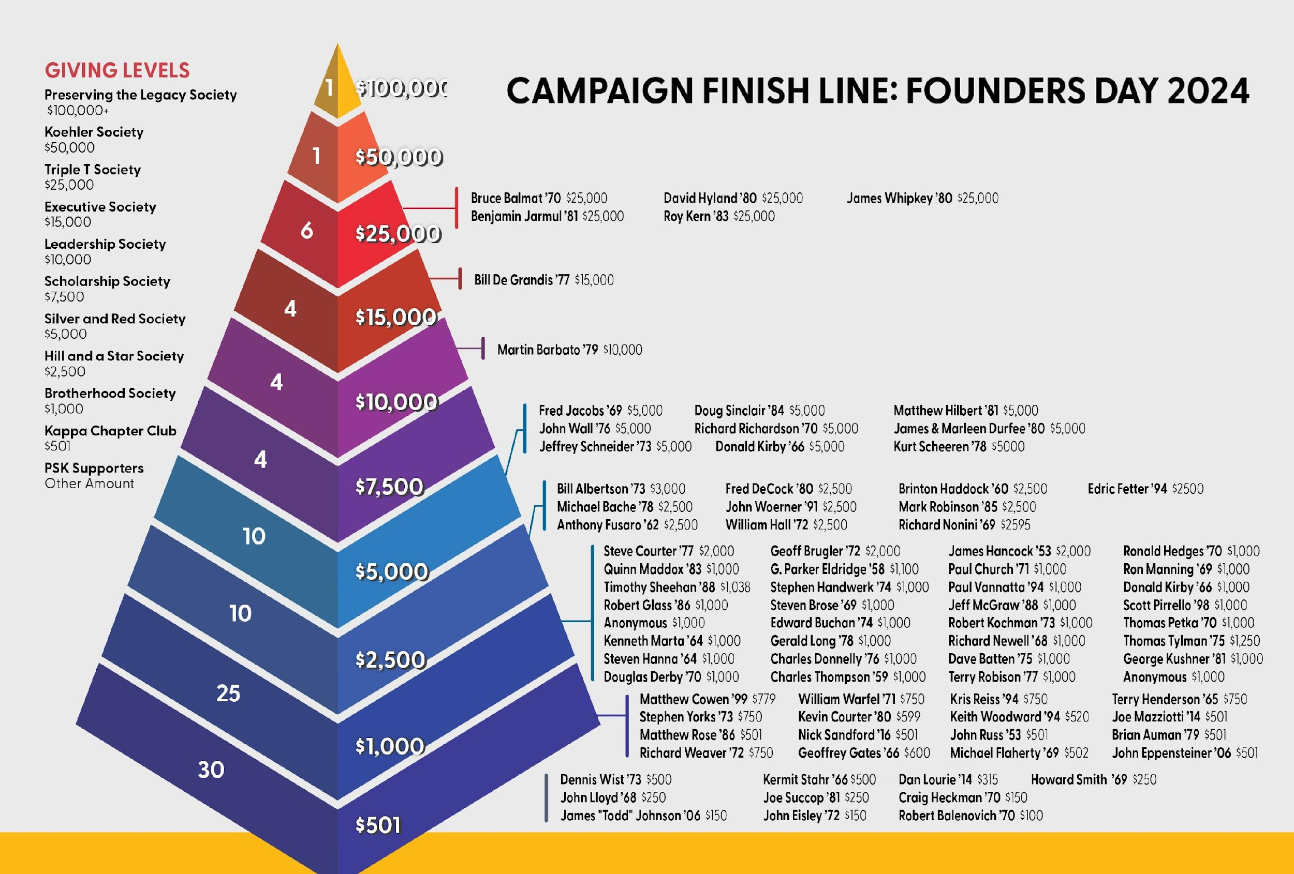
THANK YOU to our Damn Proud Supporters!

Slide 25

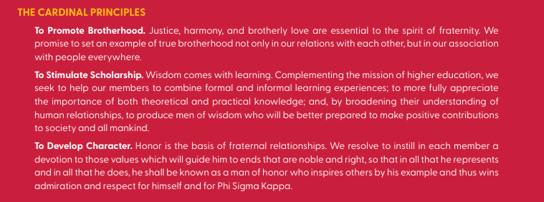
Capital Campaign Update
Thank You to Our Brothers!
To all the brothers who have pledged and donated to the Damn Proud Campaign, we extend our deepest gratitude. Your generosity is a testament to the enduring strength of our brotherhood and our shared commitment to preserving the legacy of Phi Sigma Kappa.
We are also proud to announce that we achieved 100% participation from our Board, showing our collective determination to strengthen our fraternity for all current and future brothers. Together, we are building a better future for Phi Sigma Kappa – one that honors our past, supports our present, and empowers the generations to come.
Thank you for being a vital part of this journey and for helping us achieve our shared vision for a brighter tomorrow. We couldn’t do it without you!
-Daniel Lourie, 2014

Slide 26
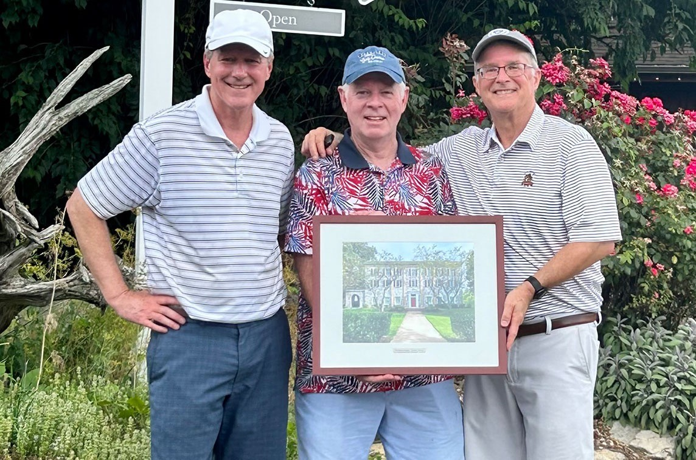
Please consider supporting the campaign
Pledges payable over 5 years
Every donor receives a beautiful framed lithograph of the House
PhiSigPSU.com/campaign

Slide 27
HOUSE TOUR

Slide 28
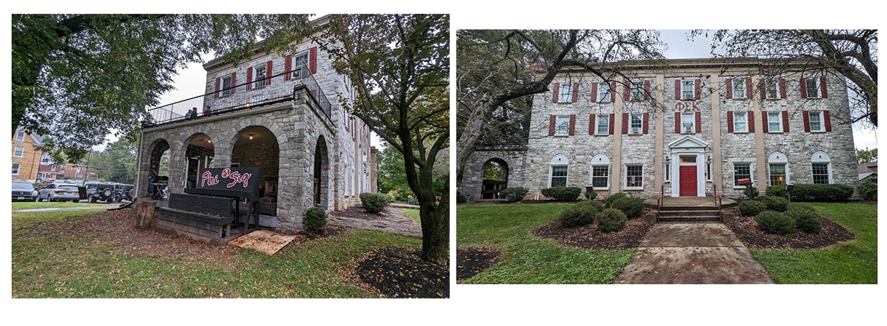
House Tour: Exterior

Slide 29
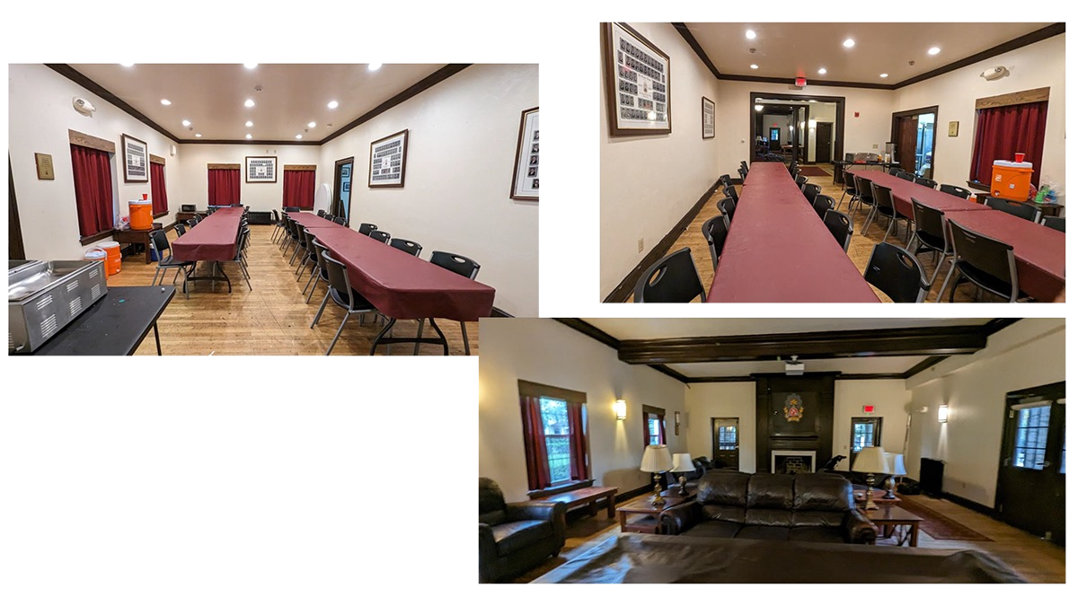
House Tour: First Floor

Slide 30
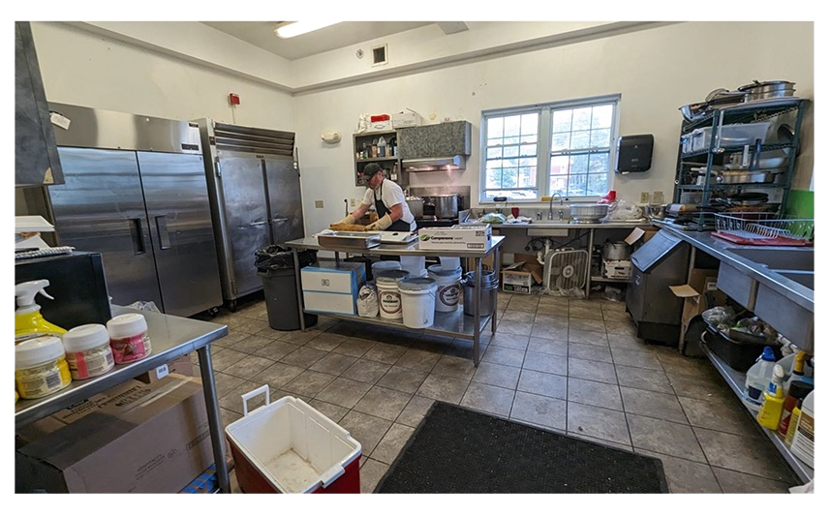
House Tour: Kitchen

Slide 31
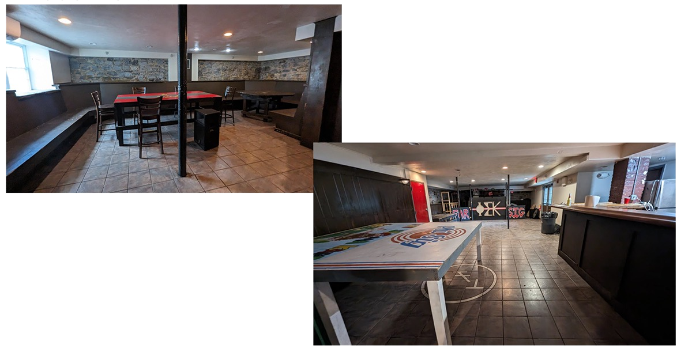
House Tour: Basement

Slide 32
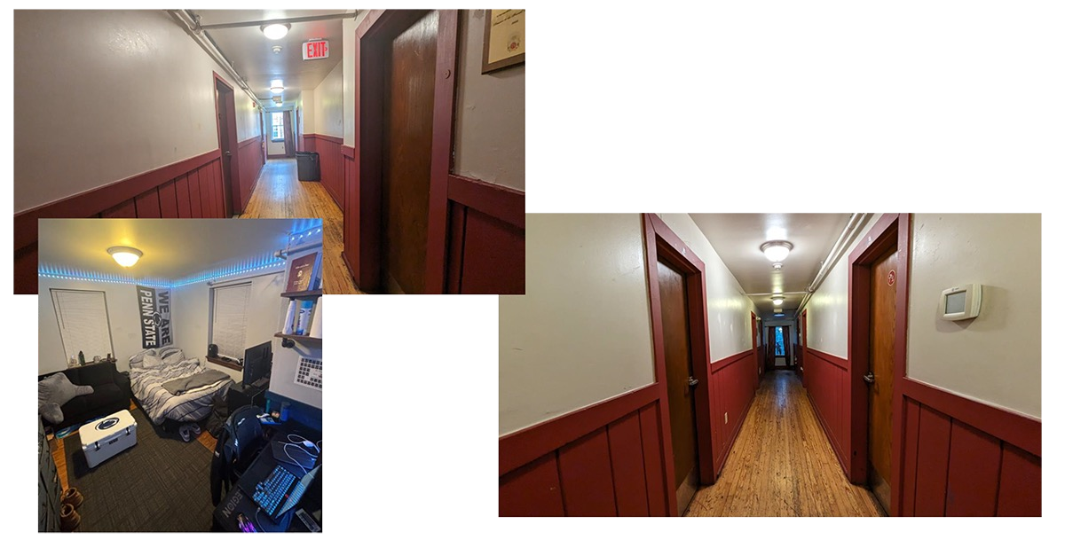
House Tour: 2nd & 3rd Floors

Slide 33
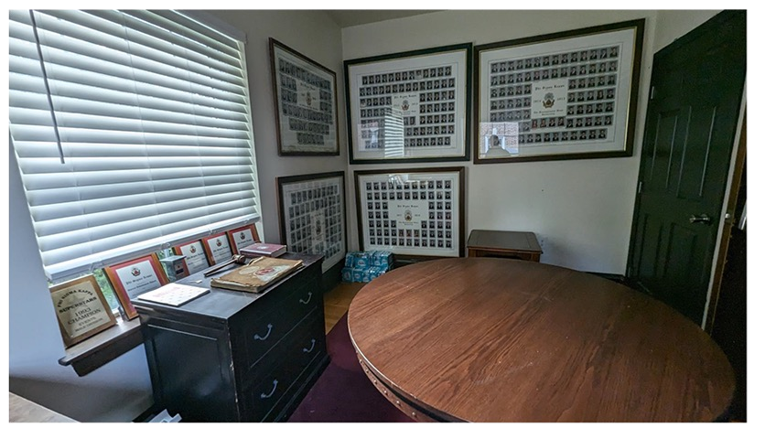
House Tour: Alumni Room

Slide 34
House Tour: Outdoor Space & Crest!

Slide 35
Q & A

Slide 36
Closing Comments
Help Us All Stay Connected:
Get your current email address, cell phone number, and mailing address information to Elevate (Emily O'Neill) at eoneill@elevateims.com.
Keep your Elevate Profile current.
Send notices of life changes (e.g., family, professional) to Elevate.
Volunteer:
Become an Advisor, help on a Special Project, and/or join the Board.
Bring your Time, Talent, and/or Treasure. You are needed. Give something.

