Slide 1
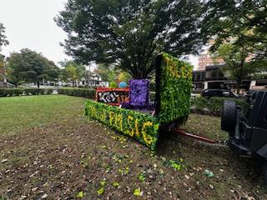
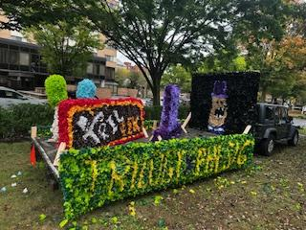

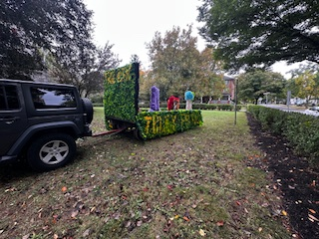
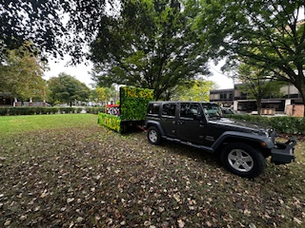
Founders Day 2026

Slide 2
Meeting Agenda
Introductions – Alumni Board, Actives Executive Board
By-law Amendment – Annual Meeting Changed to Founders Day
State of Actives
State of Brotherhood
Cardinal Principal Scholarship Award
Actives’ Man of the Year Award
Alumni Lifetime Achievement Award
Capital Campaign Update
Q&A
Adjourn

Slide 3
Alumni Board & Officers
Board Members
Bill Albertson (1973)
Steve Handwerk (1974)
Martin Barbato (1979)
Bruce McKinney (1979)
James Durfee (1980)
Matt Rose (1986)
Dan Lourie (2014)
Joe Mazziotti (2014)
Nick Sandford (2016)
Advisors to the Board
Ronald Manning (1969)
Fred DeCock (1980)
Peter Spiotta (2020)
Regis Capoferri (2022)
Chapter Advisor – Mark Robinson (1985))

Slide 4
Alumni Board & Officers
Officers
President – Martin Barbato
Vice President - Matt Rose
Treasurer – Bruce Balmat (interim), Nick Sanford
Secretary – Joseph Mazziotti
Chapter Advisor – Mark Robinson (1985))

Slide 5
Actives Executive Board & Other Leaders
President - Evan Scarton
Vice President- Zach Miller
Treasurer- Ethan Schlatner
Secretary- Joe Loehle
Inductor- Evan Pennock
Sentinel- Stephen Kraus
Head Risk- Jason Wang
Head of Recruitment- Shay Jain
Alumni Relations – Jasper Abrahams
House Manager- Shaun Whistler
Head Social- John Jacobson
Head Thon- Andrew Boyle

Slide 6
Grand President Founders’ Day Message
Brothers,
Today, as we celebrate Phi Sigma Kappa’s 153rd birthday, I am reflecting on the origins of our Brotherhood and the role Phi Sig continues to play in developing leaders - campus leaders, community leaders, business leaders.
How we think about developing leaders is ever evolving: innovation is top of mind.
Over the past year we have revamped the format and time of our marquee undergraduate training programs: Conclave Officer Academy and the Shonk Leadership School. We held our first alumni and volunteer town hall. And next month we will be meeting with the parents of undergraduate Brothers.
We are also proud to announce that every chapter now has its own dedicated website, powered through myPhiSig. Unlike social media accounts that can go quiet, get lost during officer transitions, or multiply into competing pages, these websites are housed within our national platform and carry forward seamlessly from one generation of chapter leadership to the next. They give alumni a reliable place to find out what is happening with their chapter, and they give active Brothers a professional home to tell their story and connect with the communities that built them. Alumni club sites will follow soon, extending that same connectivity to our local alumni communities across the country.
Chapter Website Example
Each of these initiatives is designed to strengthen our Brotherhood consistent with the vision of our Founders.
Lastly, thank you for the honor of serving as your Grand President.
DP
David Cohen ‘88 Beta Chapter/Union College
Grand President

Slide 7
Special Meeting
Pursuant to Section 3 of Article IV, Meetings, the President called a Special Meeting. Notice was given in the President’s Fall 2025 Newsletter.
Proposal: Amend the By-Laws, Section 1 of Article IV, Meetings, as follows: “A general membership meeting shall be held once per year on the weekend designated to celebrate Founders Day.”
Proposal: Terms for Directors and Officers shall be adjusted to coincide with the change in the date of the annual general membership.

Slide 8
Special Meeting
Terms through Founders Day 2027: Martin Barbato, James Durfee, Joseph Mazziotti
Terms through Founders Day 2028: Steve Handwerk, Bruce McKinney, Matt Rose
Terms through Founders Day 2029: Bill Albertson, Nick Sanford, Dan Lourie
Officers through Founders Day 2027:
Martin Barbato – President
Matt Rose – Vice President
Nick Sanford – Treasurer
Joe Mazziotti – Secretary

Slide 9
State of Actives
By the Numbers
Total Actives - 39
In-house Actives – 18
New Associate Members- 12
8 students unable to register this semester plan to register and move in in the fall semester
Shoutout and thank you to Bruce and Shay for their help and dedication to recruitment this semester.
THON
Raised a new house record of $228,954.73.
Came in at #9 with our thon partner Trilogy in the top 10 most money raised between Greek Organizations.
Travel
Fall Formal in Toronto
Spring Break- Trinidad, Bahamas, Florida, Puerto Rico

Slide 10
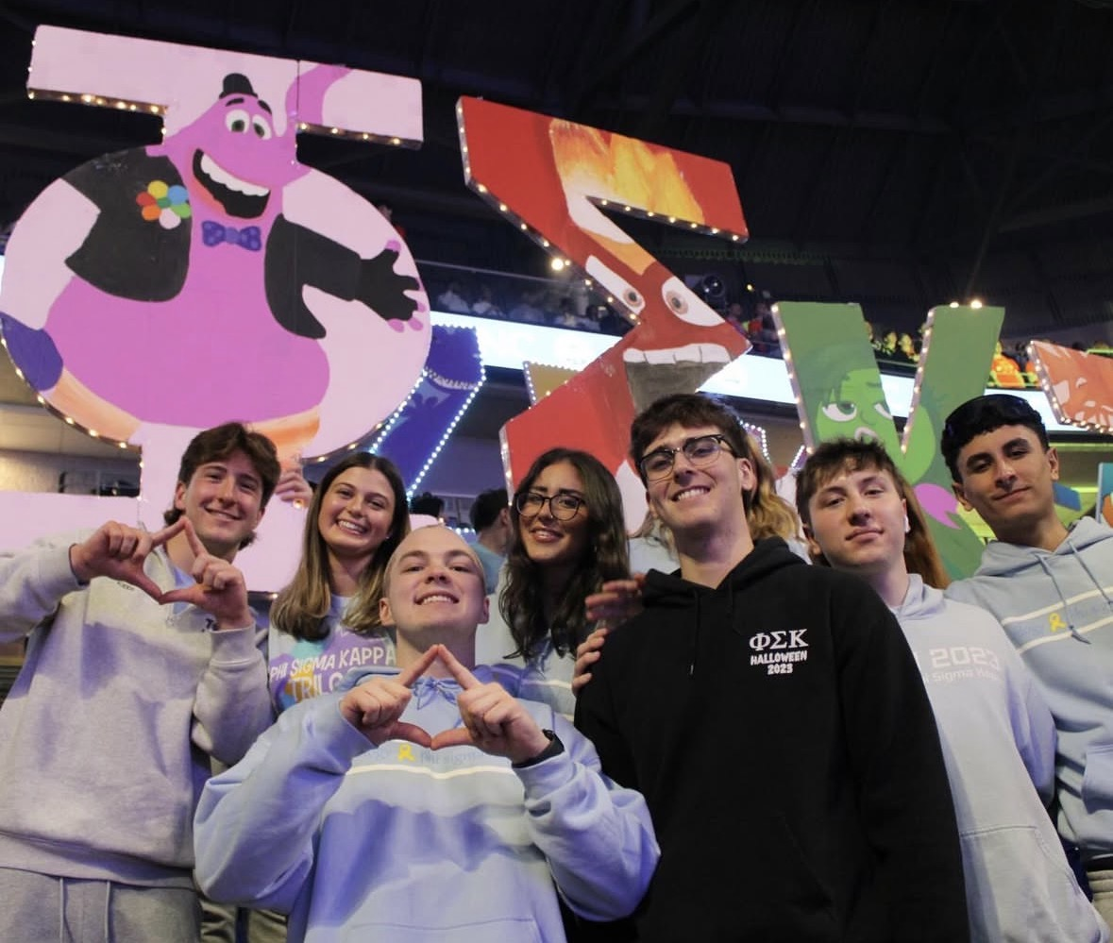
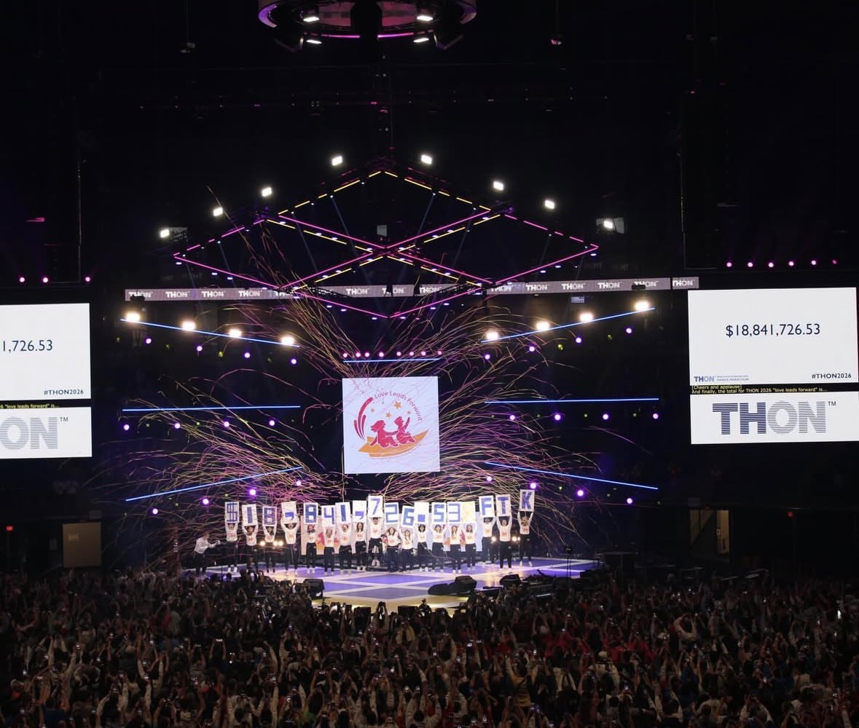
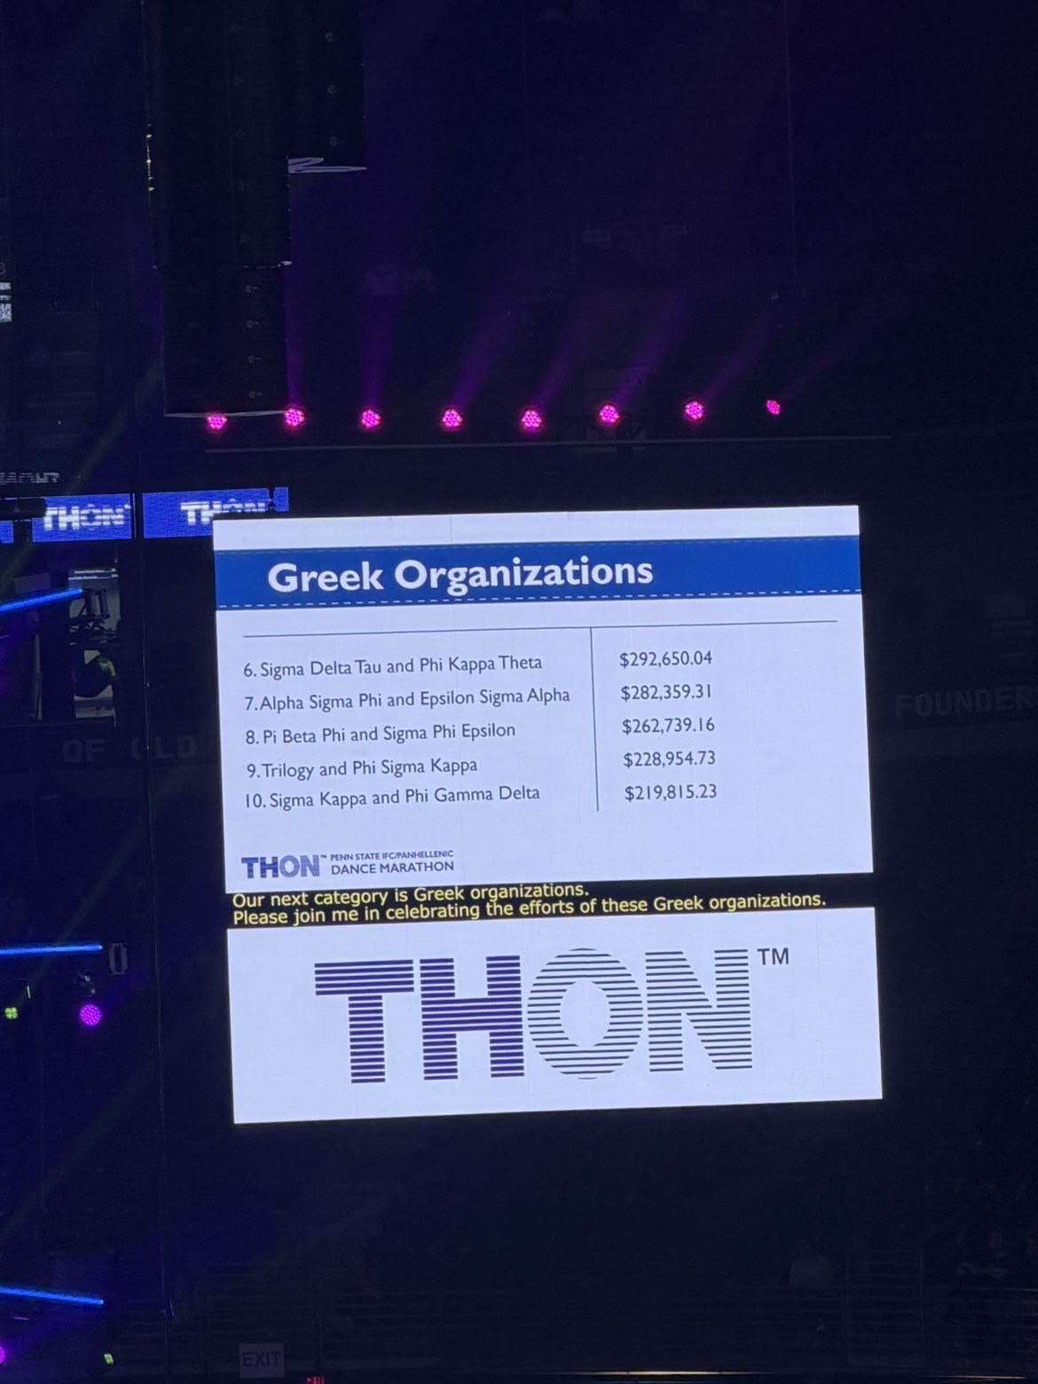
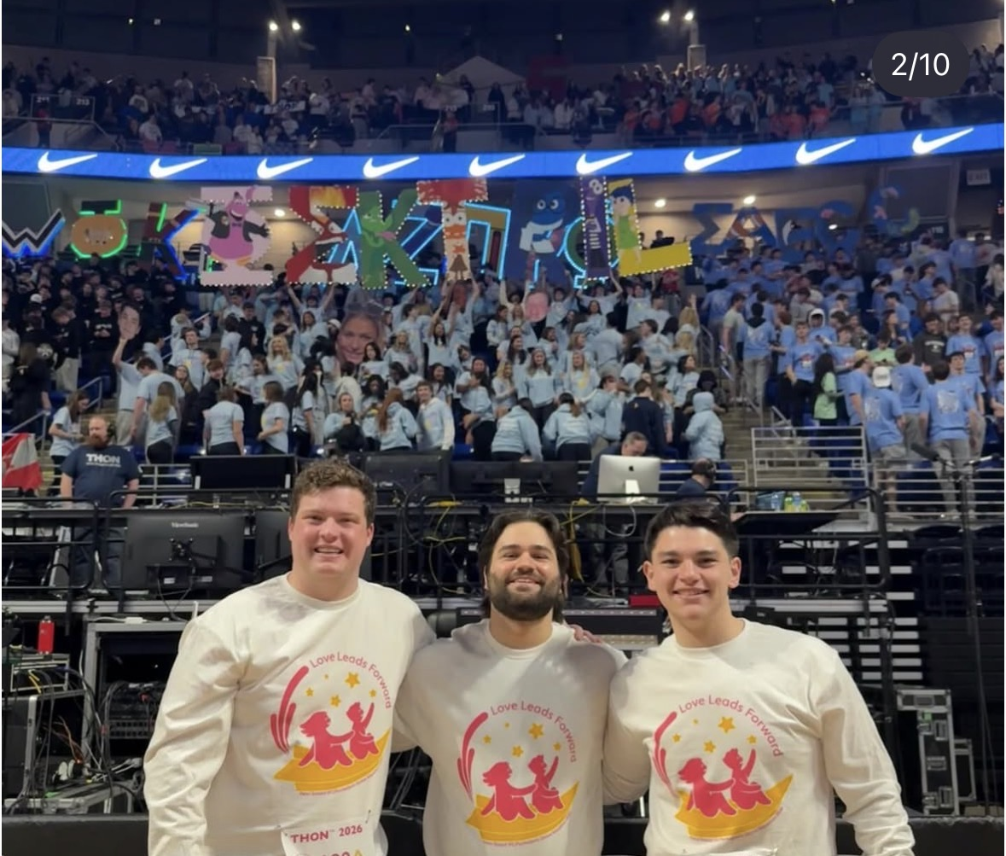
Thon Chairs- Head: Andrew Boyle Fundraising: Carmen Pannucio, Will White Family Relations: Marko Kosanovich, Evan Lipp Alumni Relations: Matthew Novak HUGE SHOUTOUT TO OUR AMAZING DANCERS MARKO, CARMEN, AND ANDREW
Thon

Slide 11
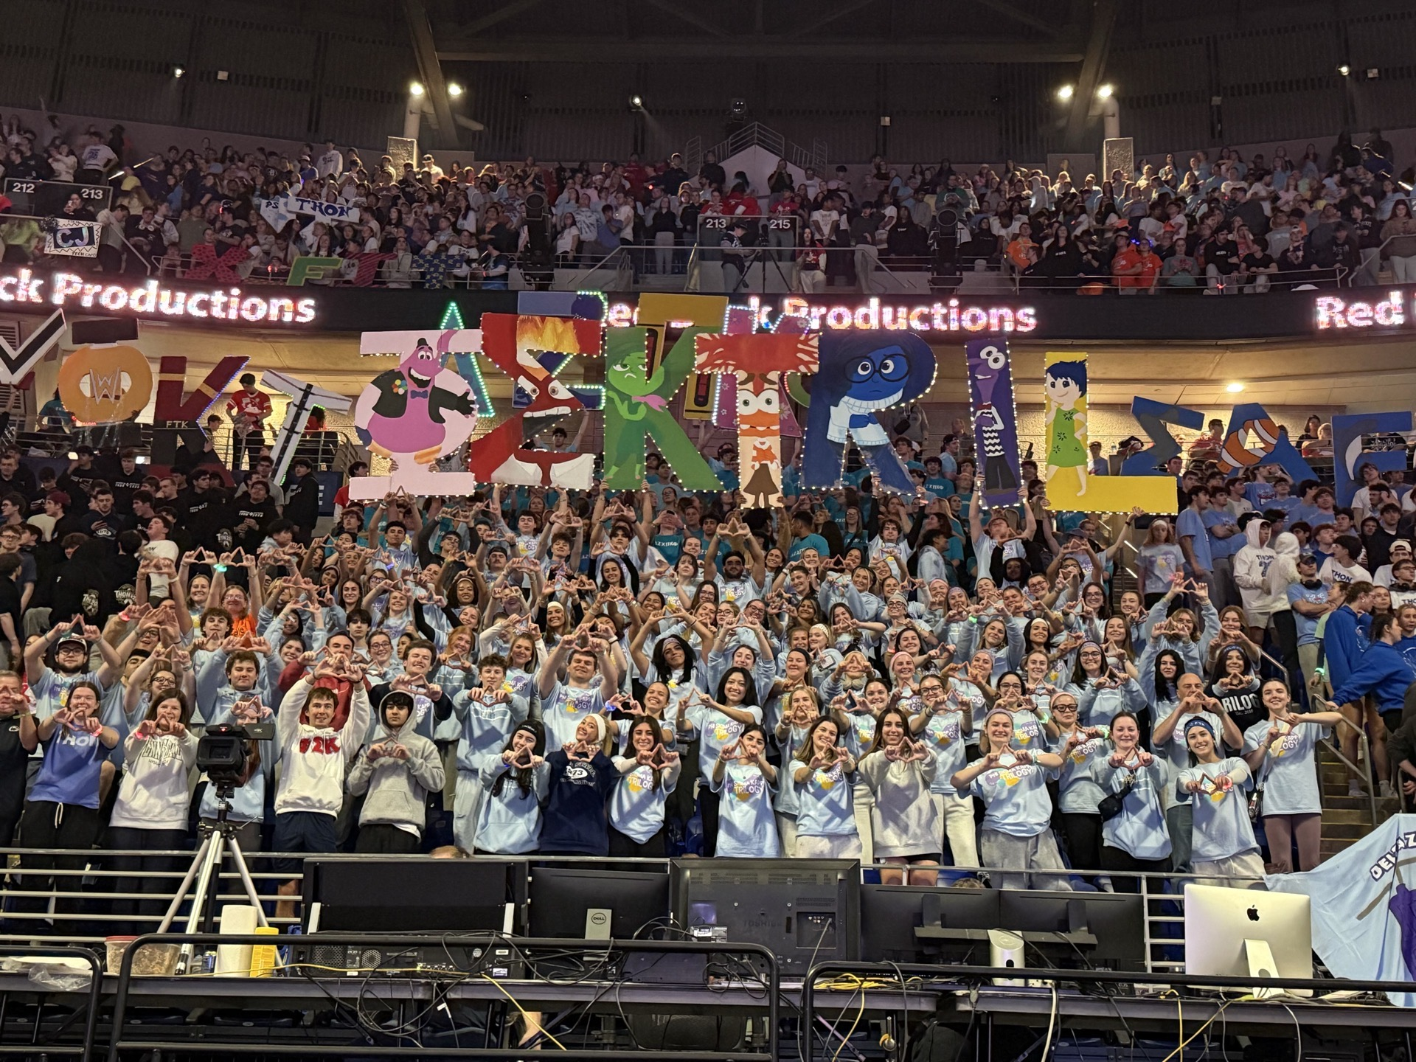

Slide 12
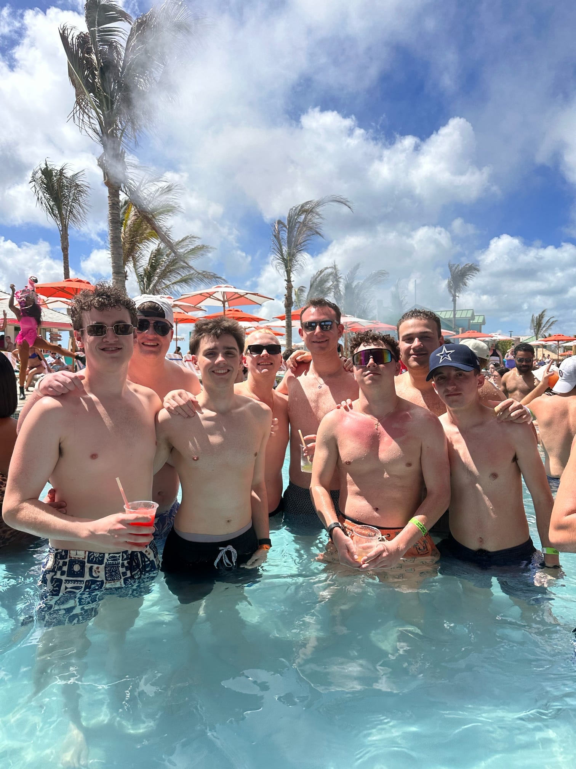
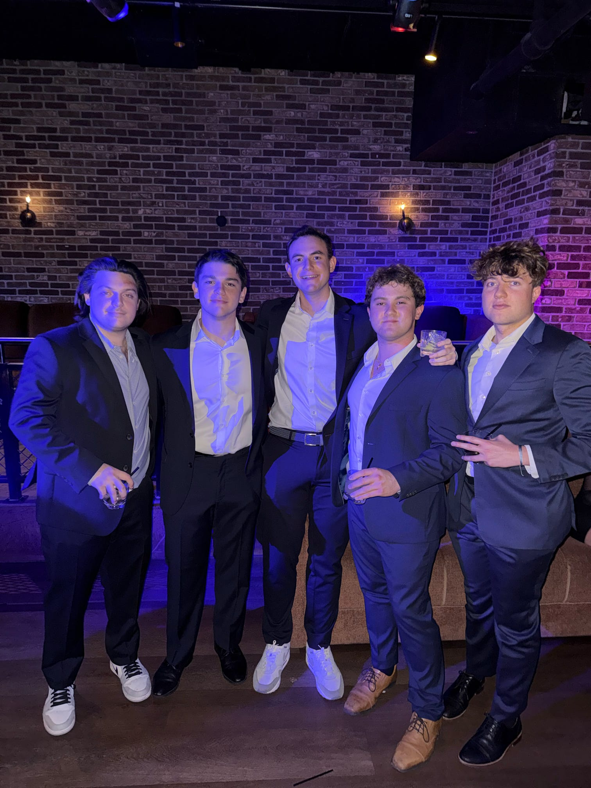
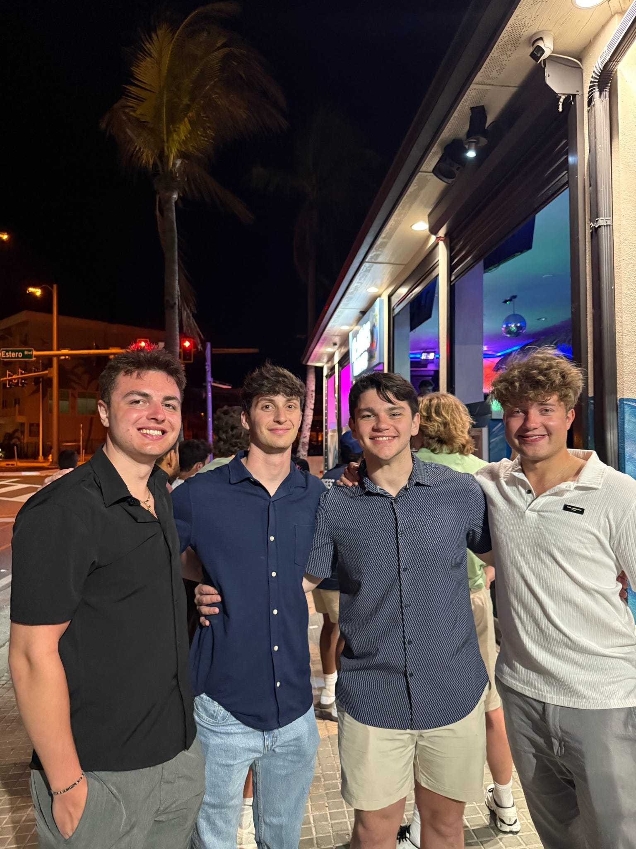
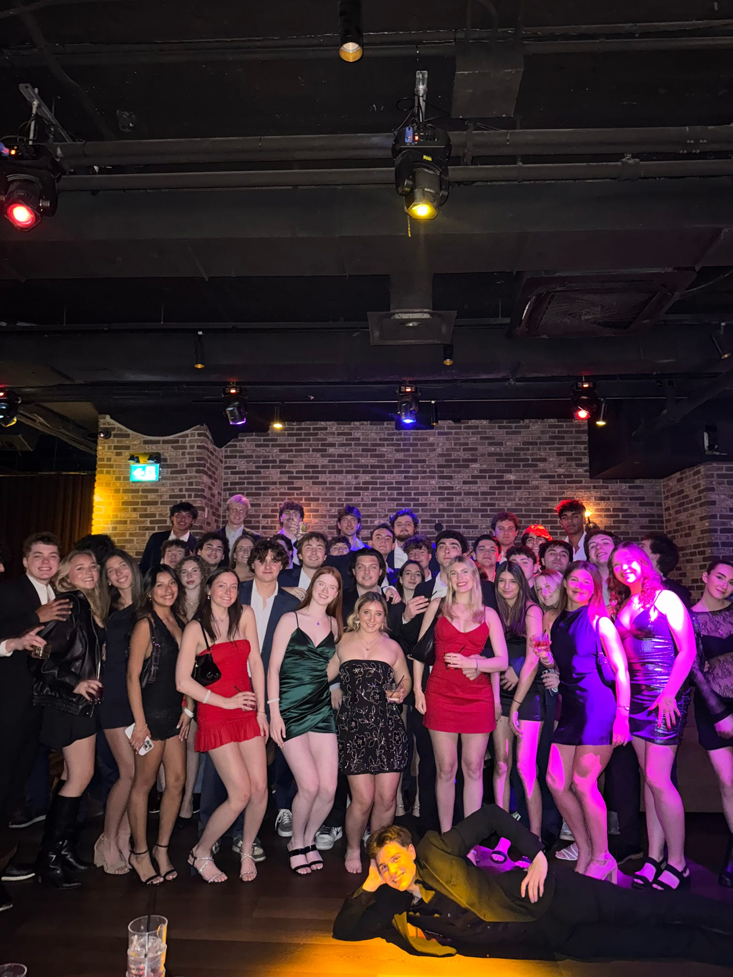
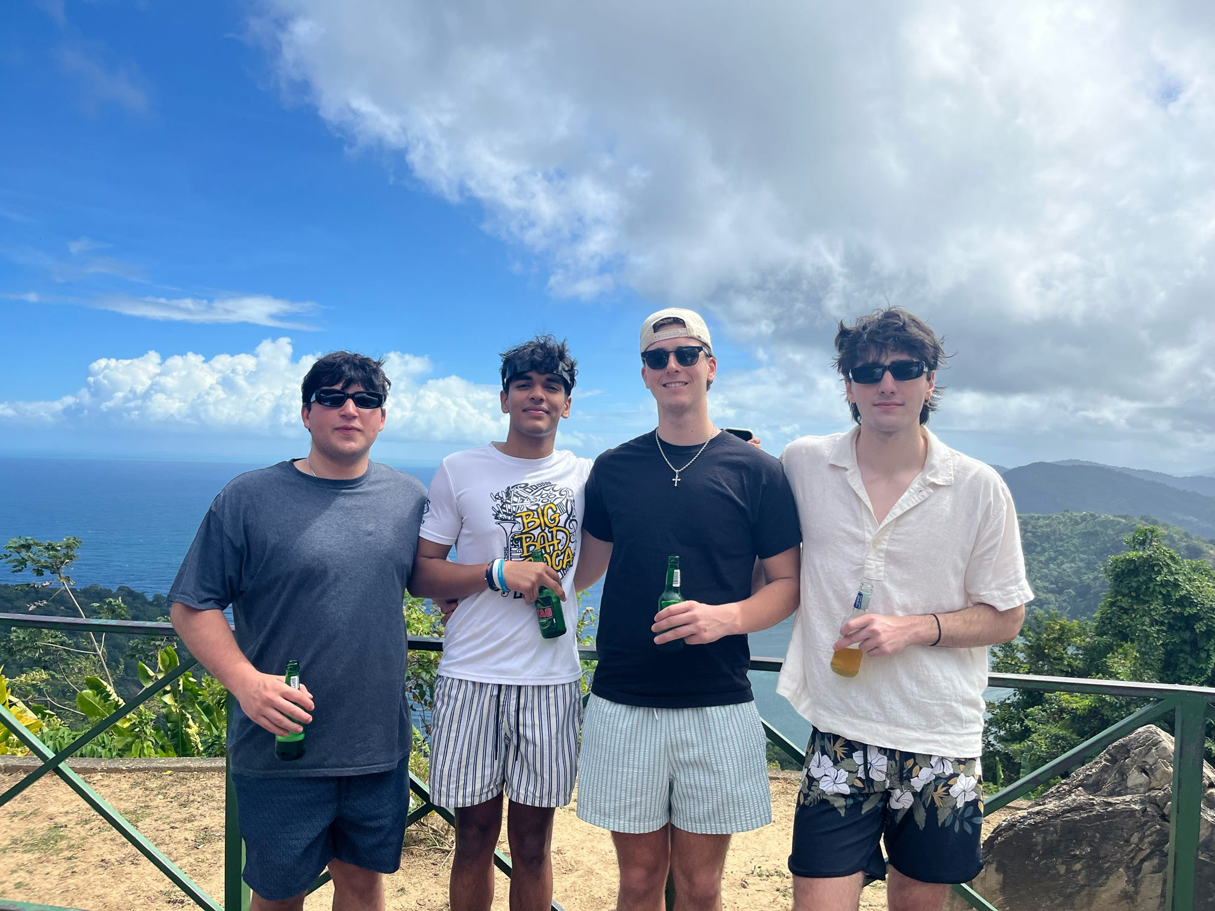
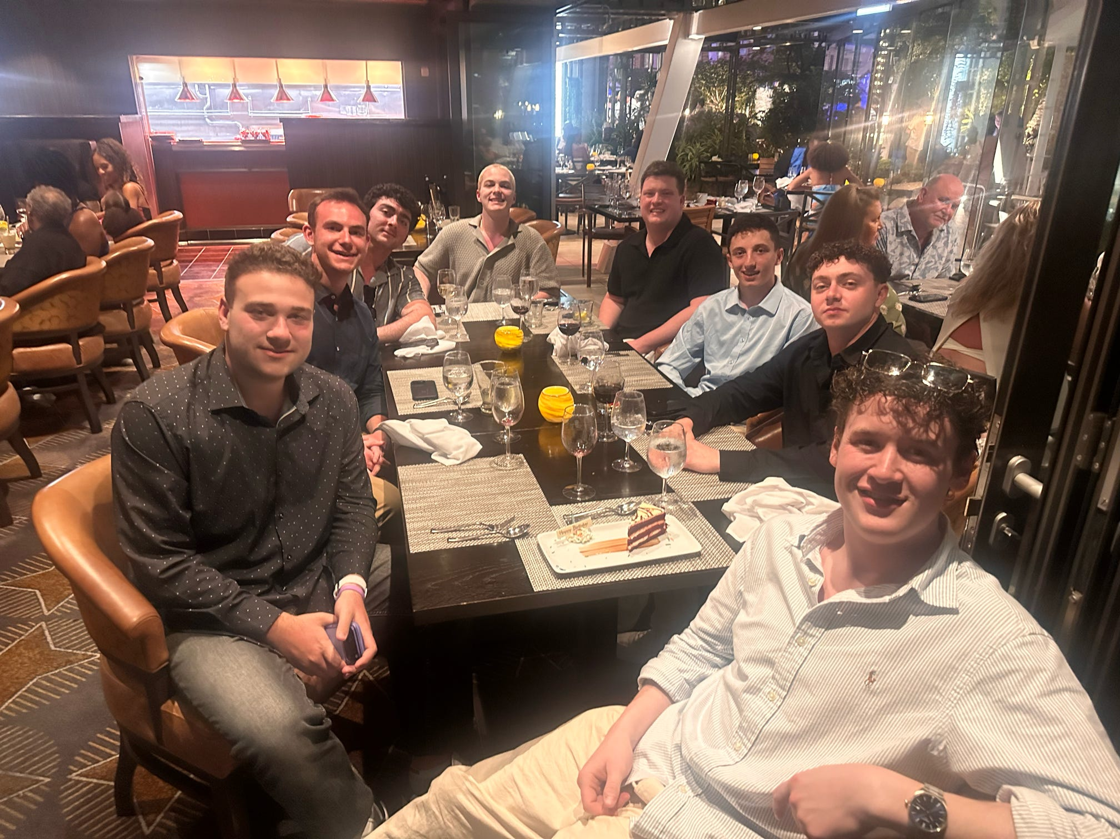
Actives

Slide 13
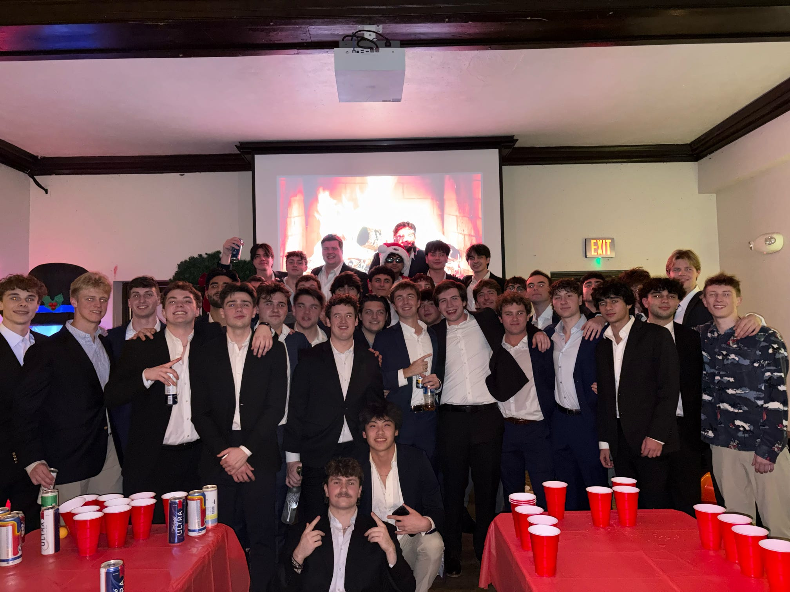
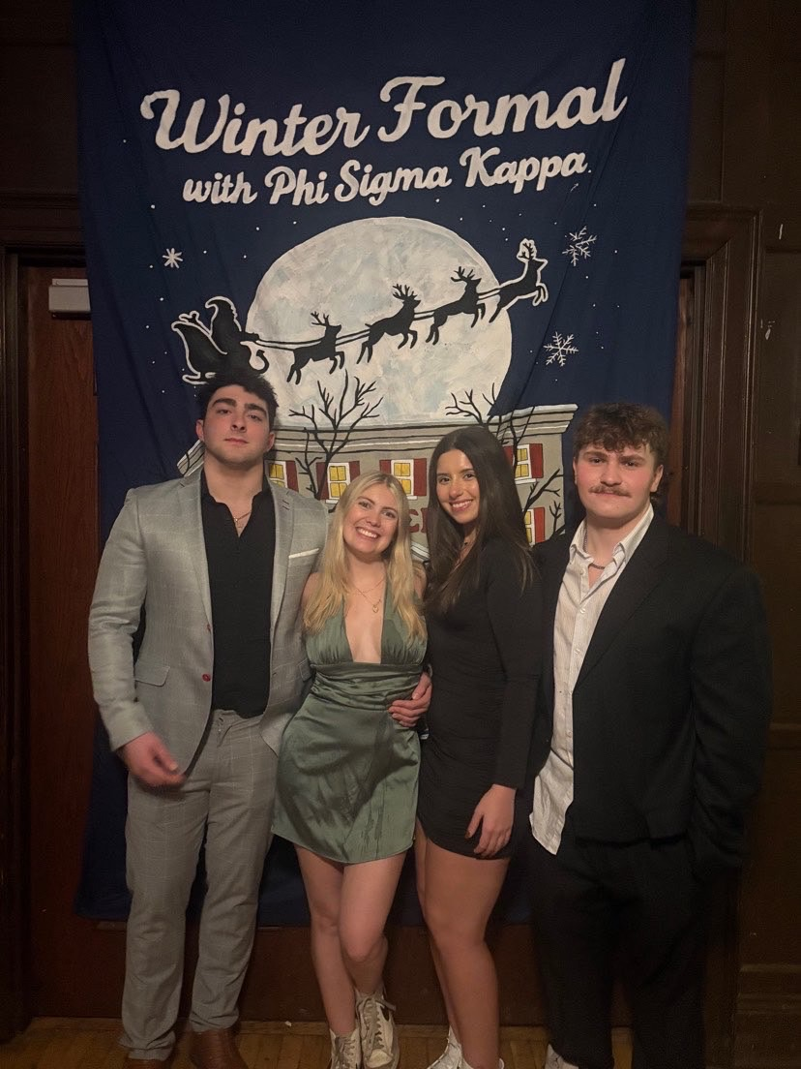
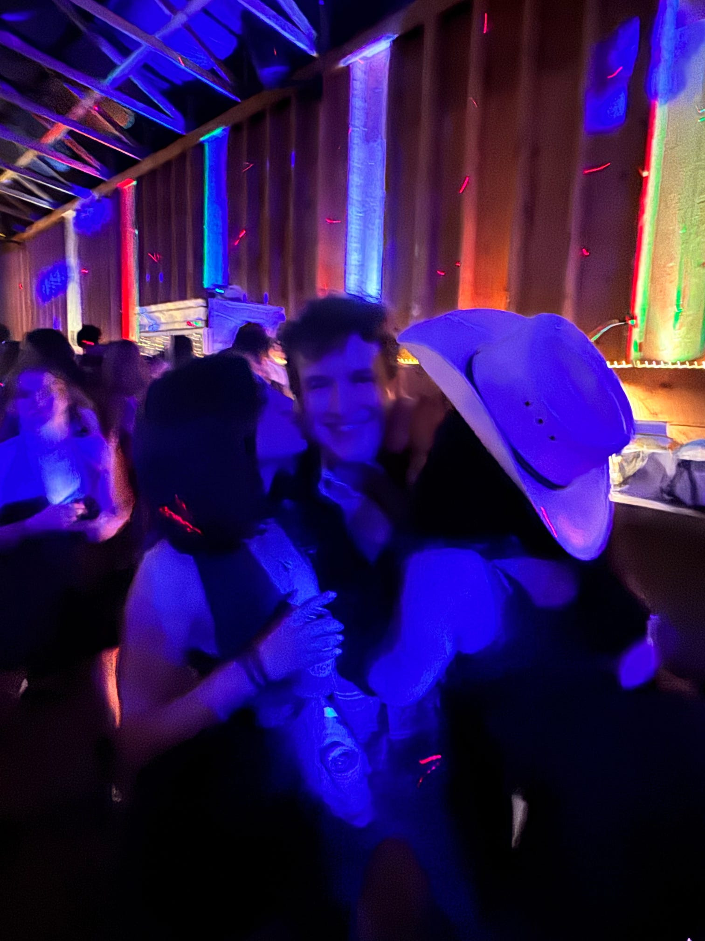
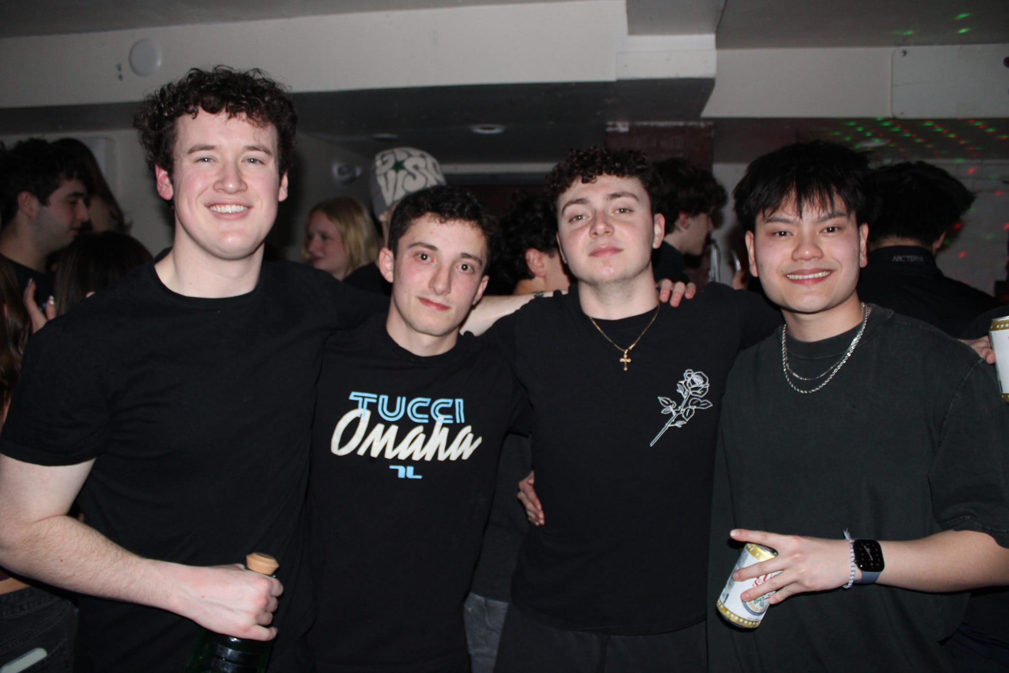

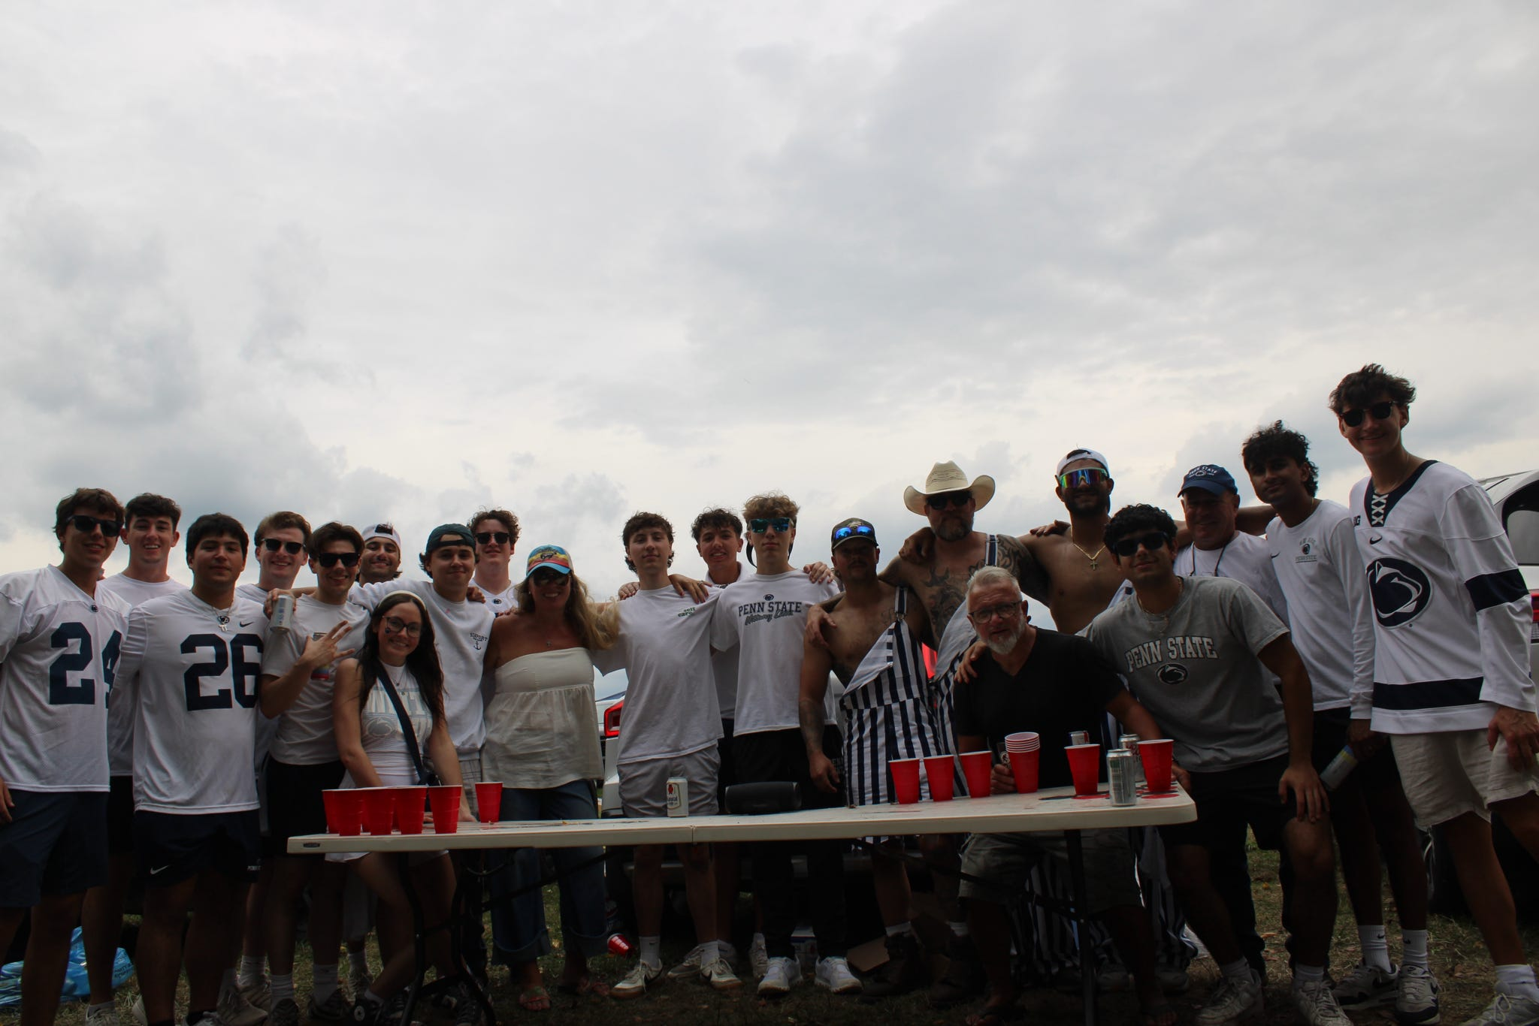
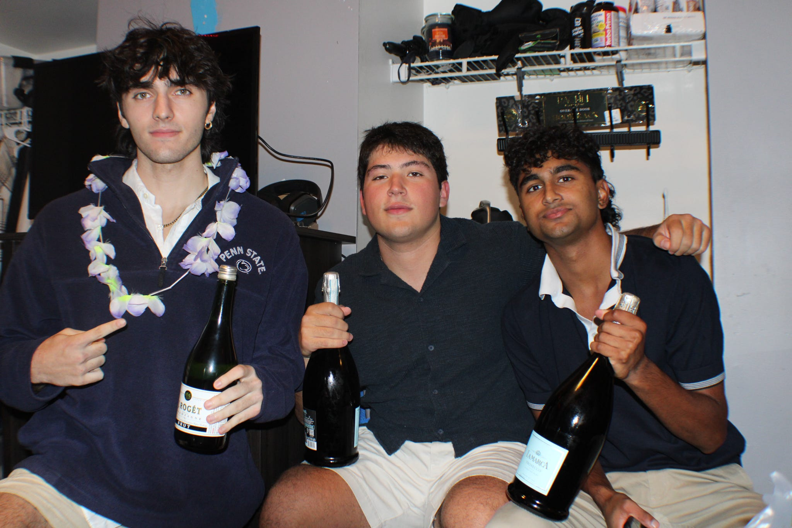

Slide 14
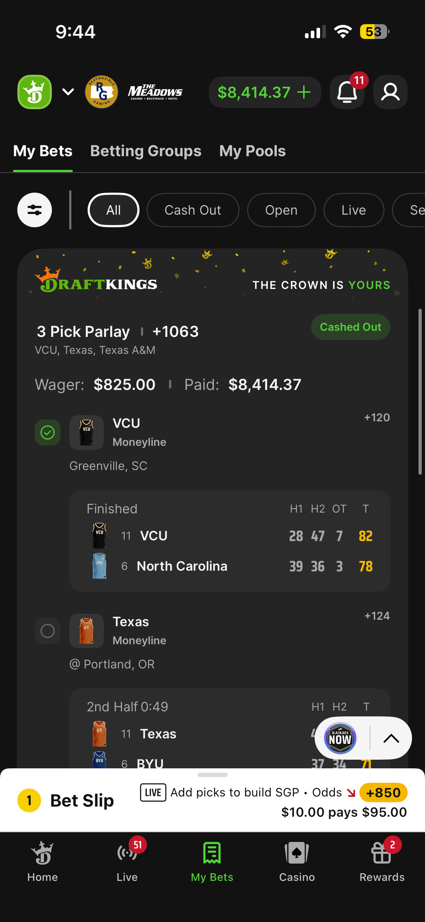
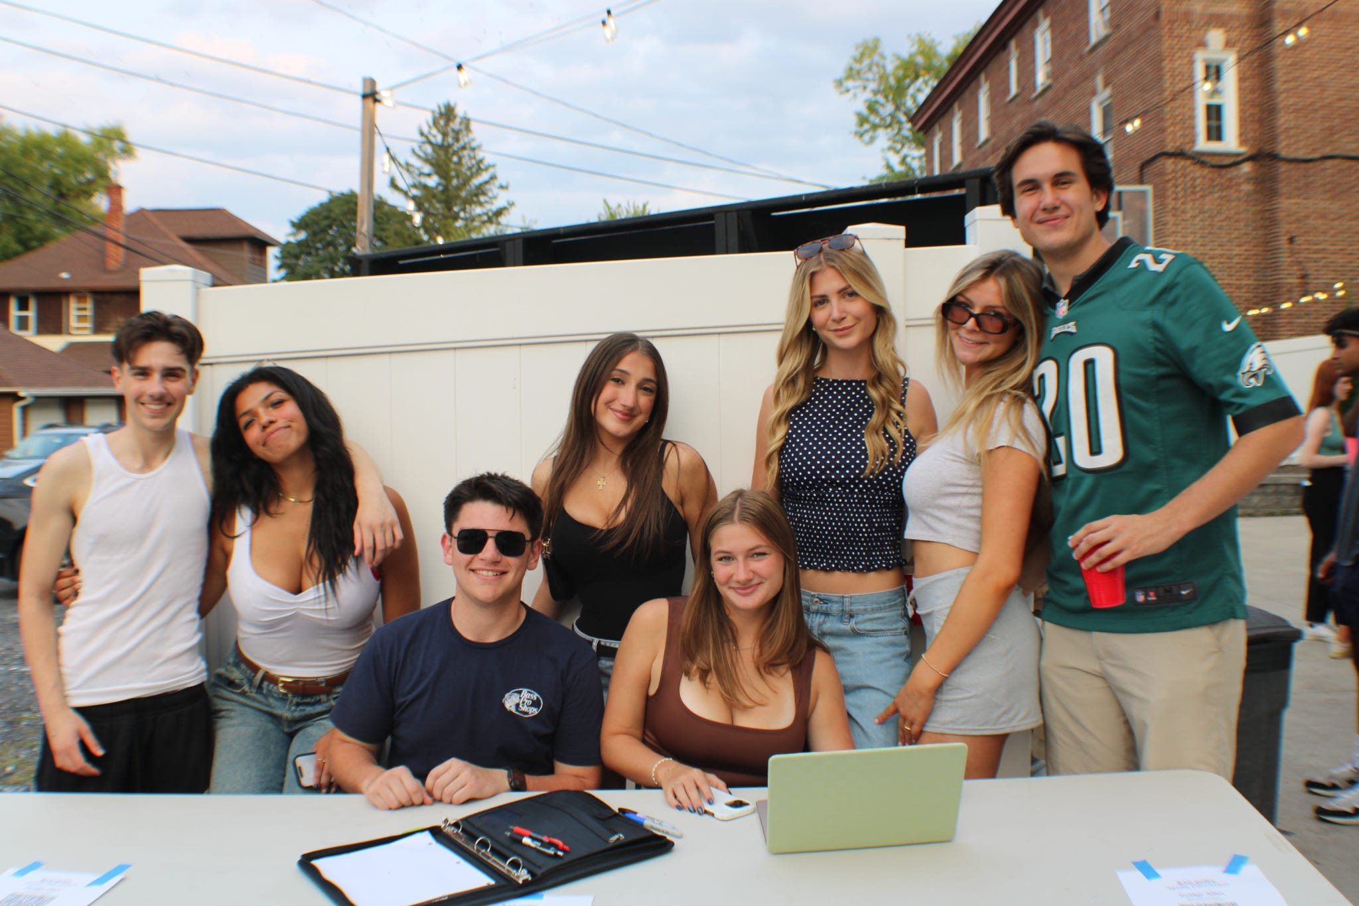
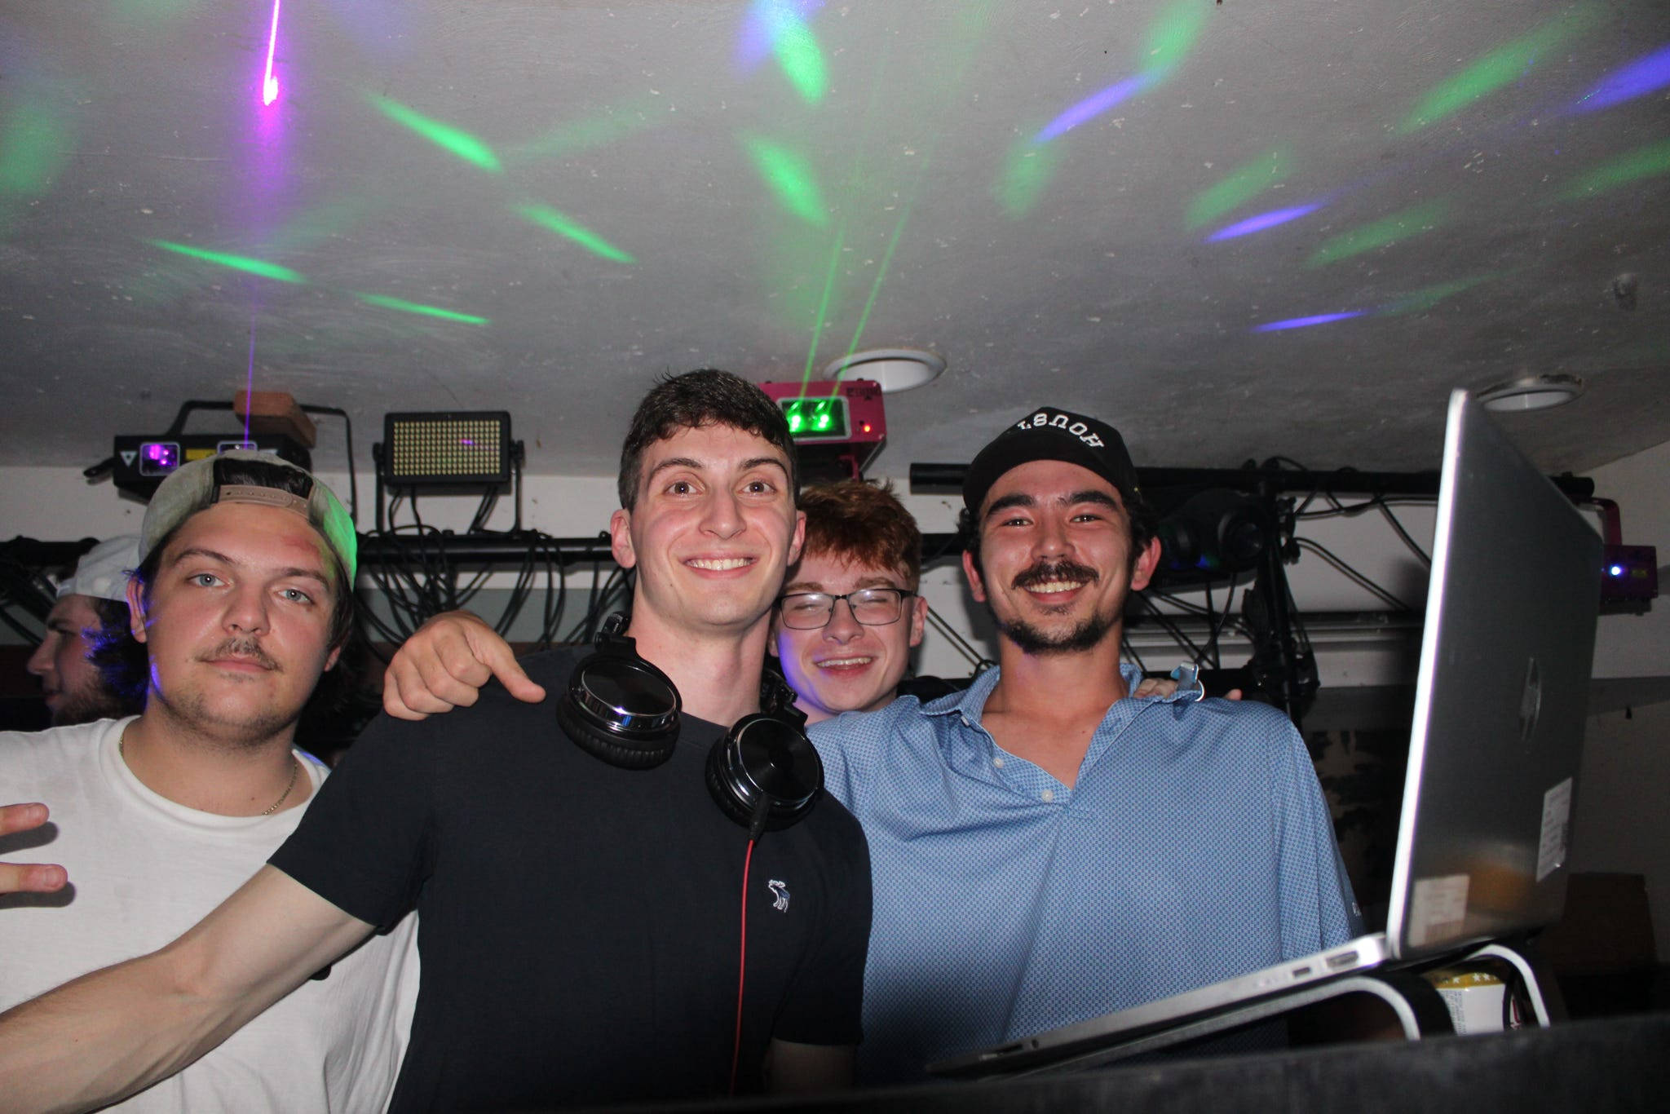
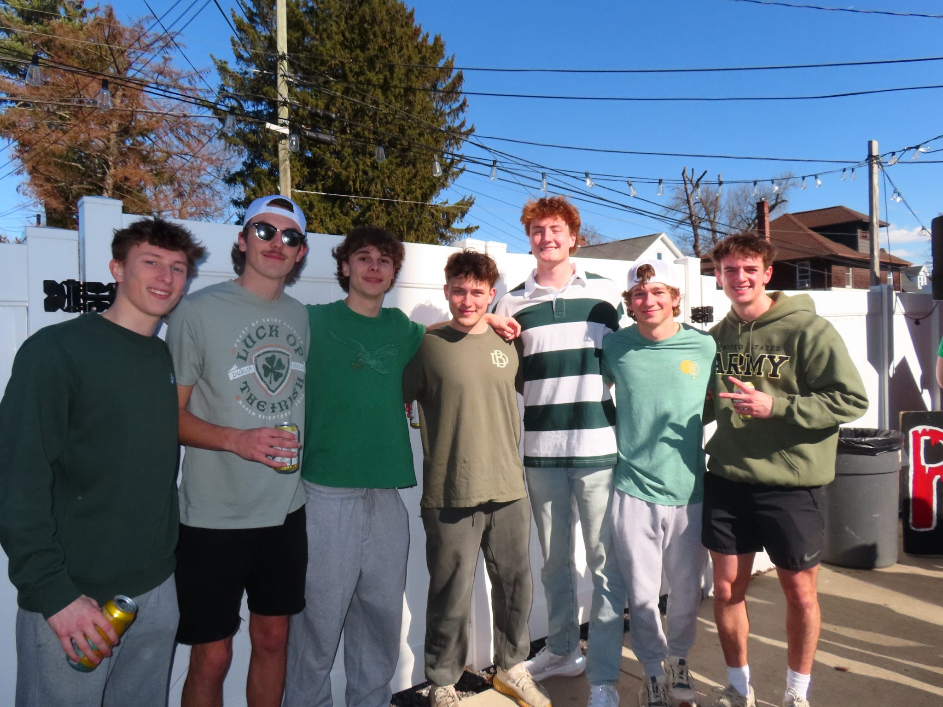
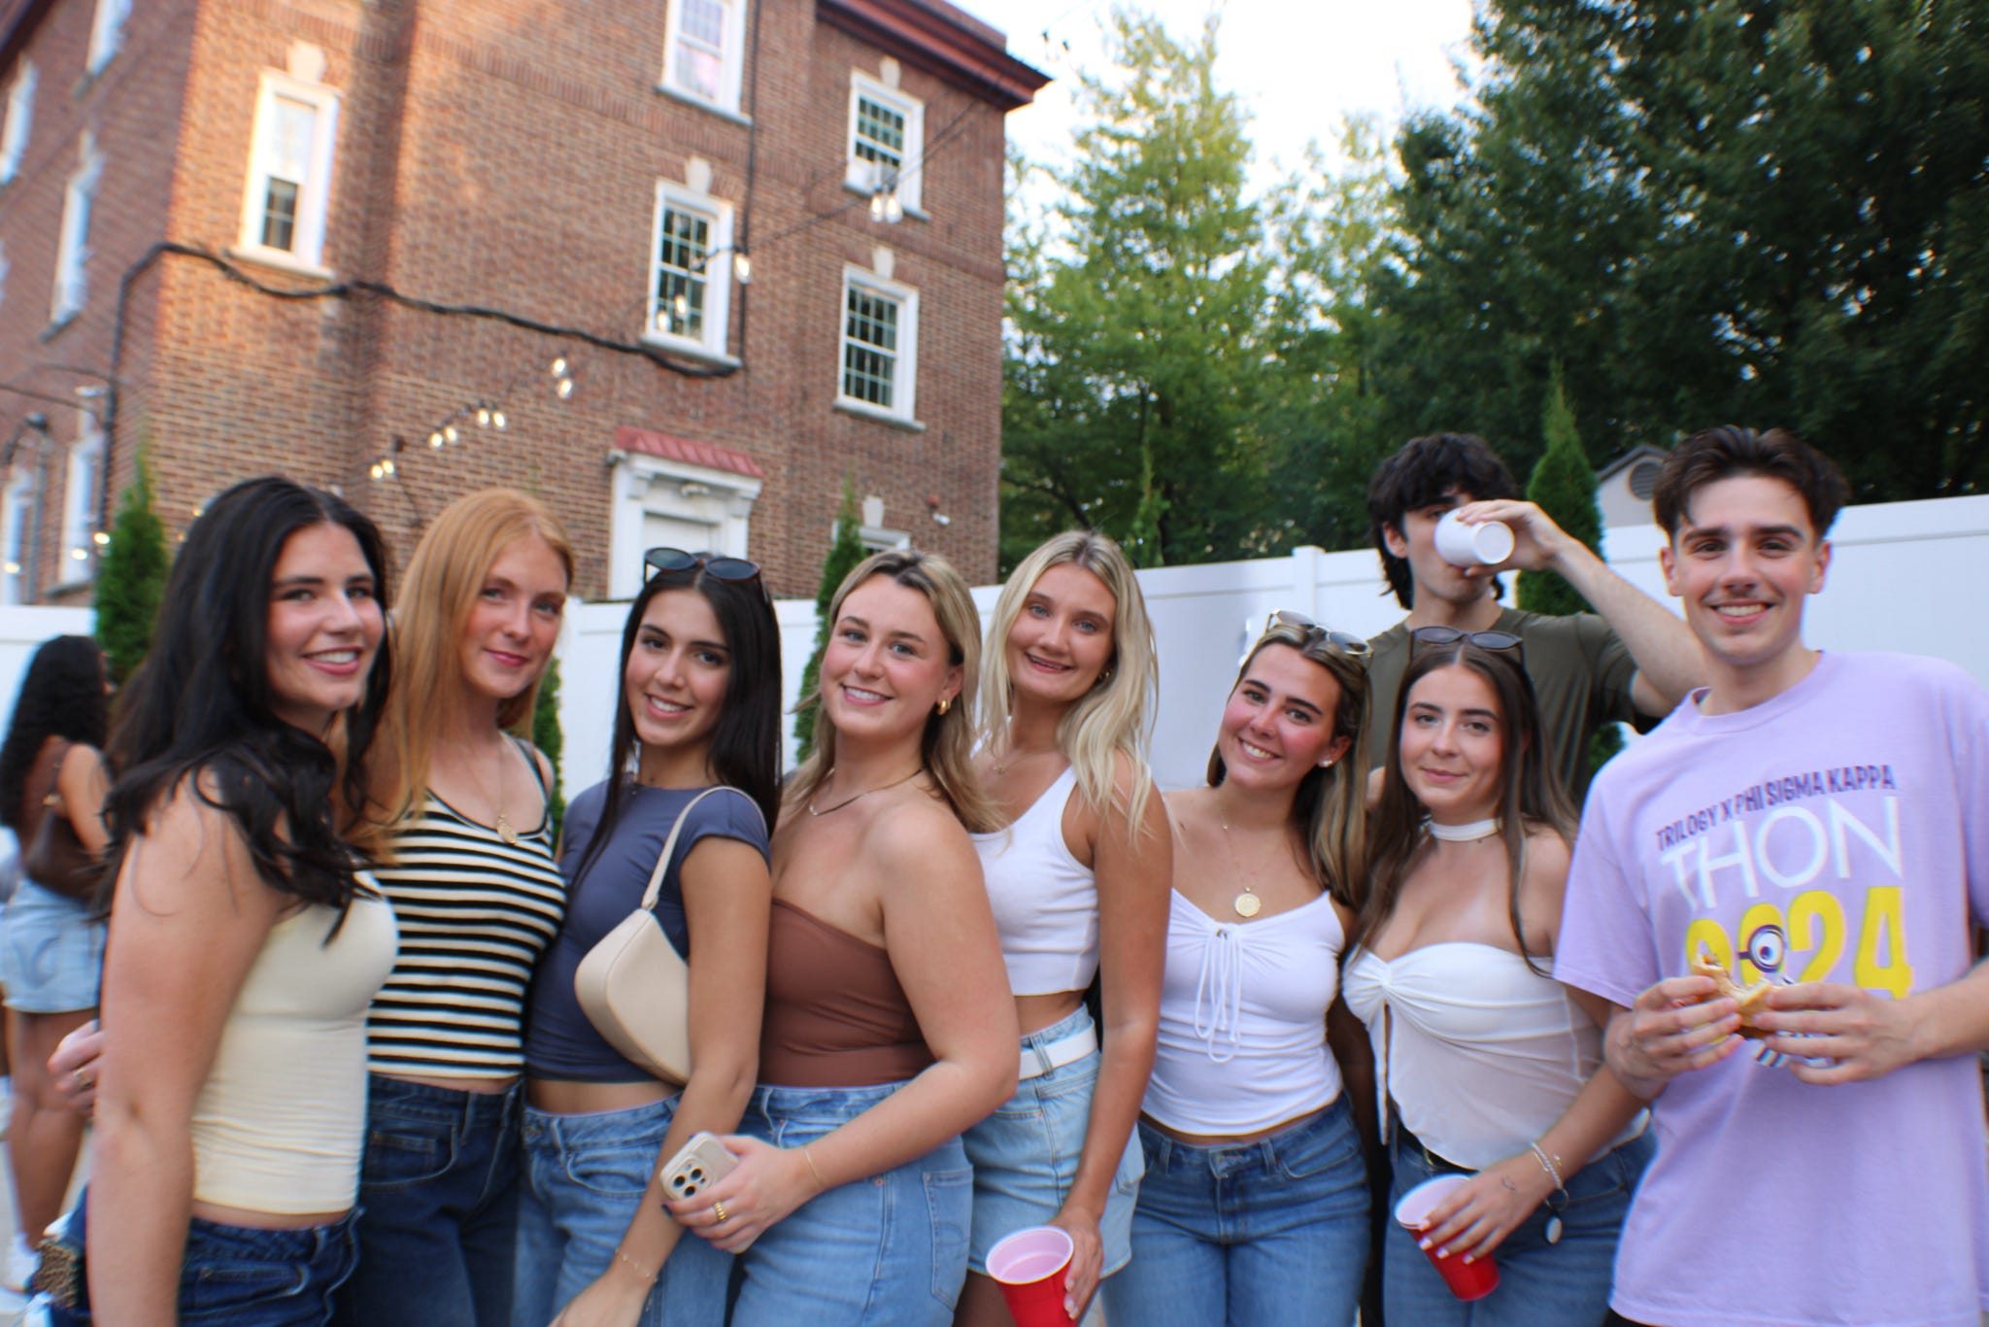
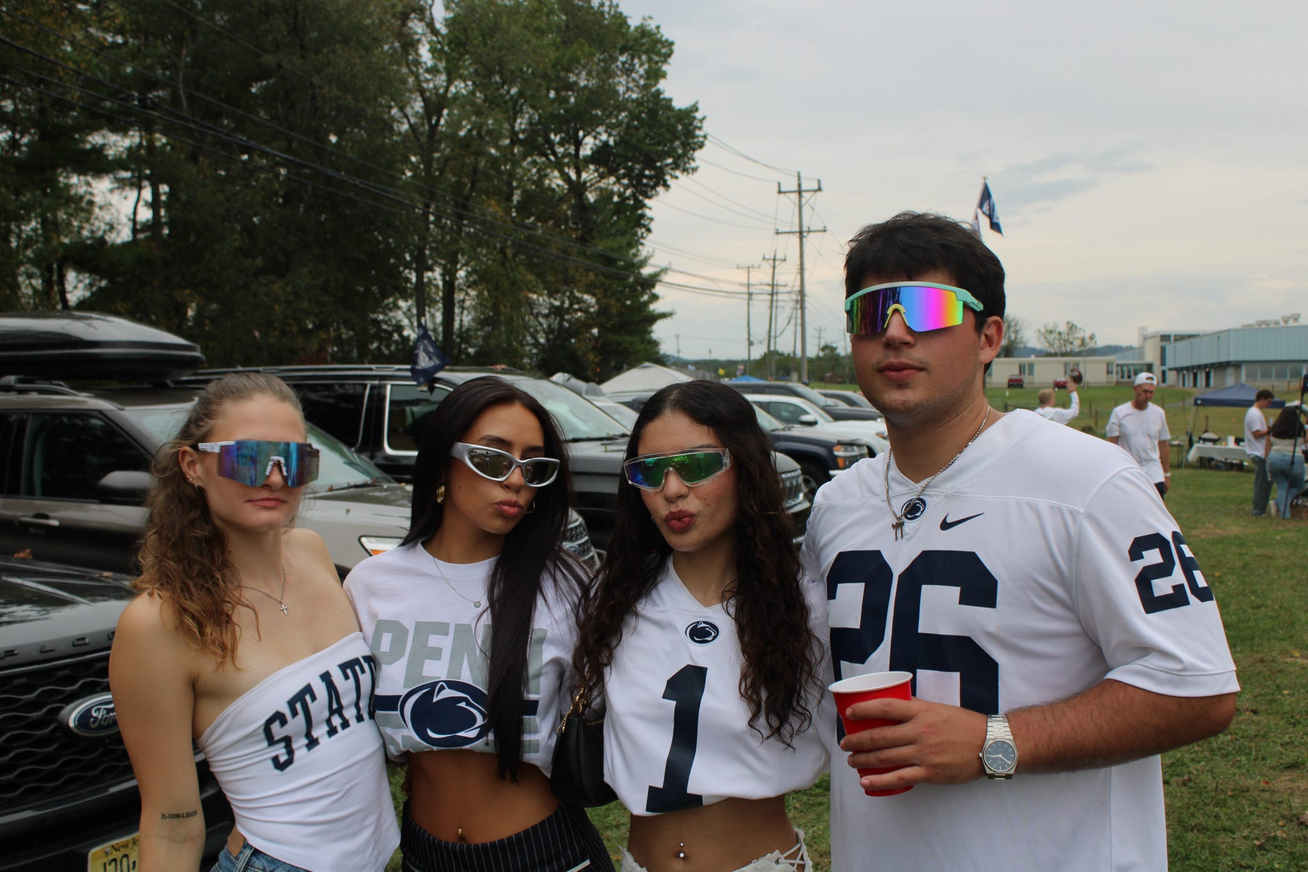

Slide 15
State of Brotherhood - Finance
Bruce Balmat – Treasurer (interim)
Finance Report
Activities include:
Housing - including support for the actives
Alumni - communications, events and scholarships
Fundraising and capital expenditures
Budget of approximately $400k for Fall 2025 and Spring 2026.
Positive cash flow on an annual basis for the academic year.
Mortgage paid in full in November 2023.
Insurance polices and property taxes all current.
Cash balance of approximately $350,575 as of March 15th 2026.
Your annual appeal and fundraising support is greatly appreciated!

Slide 16
State of Brotherhood - House
Matt Rose, Chair – House Committee
State of the House
House is in good shape - Nittany Co-op continues weekly inspections and facilitates repairs.
General operating systems functioning well.
Capital Projects
New Boiler Installed
Replacement of flooring for 2nd and 3rd floor halls scheduled for the summer of 2026
Received scaled down quote for kitchen. Includes new range, deep fryer, hood with fire suppression system, and make up air unit.

Slide 17
State of Brotherhood - Alumni
Martin Barbato – President
State of the Alumni – By the Numbers (As of Homecoming 2025)
Total of 1,017 living alumni
Have valid email for 469 alumni , regular mail addresses for 728 alumni.
Have valid cell phone numbers for 672 alumni.
Please ensure your information is current.
Please help with missing brothers.
Help Us All Stay Connected
Get your current address information to Emily Wanner at: eoneill@elevateims.com
Keep your Alumni Profile current.
Send notices of life changes (e.g., family, professional) to Emily.
Opt in to accept text messaging from PSK/Elevate
Website Portal: www.PhiSigPSU.com
Future Events/Celebration
100 years of Kappa Mansion – February 21, 2027

Slide 18
State of Brotherhood - Alumni
Special Committees (announced at Homecoming 2025)
Alumni-Active Committee
Single focus: Fostering Connections between Alumni and Actives for Mentoring. Why? To positively impact recruitment.
Capital Investment Committee
Historical Preservation Committee
Digitization of Records and Composites.
Alumni Accomplishments and Chapter Eternal. Getting information onto Elevate website. Explore auto feed from Penn State
Opportunities for Alumni to get involved

Slide 19
Cardinal Principals Scholarship Award
Single award, presented by the Alumni, that acknowledges the Active who best exhibits the qualities of our cardinal principles:
BROTHERHOOD:
Leadership positions held (Chapter, University, PSK National levels)
“Good standing” – free of debt, or alumni board approved payment plan in place
Number of semesters lived in house
SCHOLARSHIP: Cumulative Grade Point Average
CHARACTER: Actives’ Input
AND THE 2026 WINNER IS…………

Slide 20
Cardinal Principals Scholarship Award
[insert]

Slide 21
Actives’ Man of the Year Award
Evan Scarton (2027)
Major: Psychology
Current President
Cresson, PA
3.3 GPA

Slide 22
Alumni Man of the Year Award
David Hyland (1980)
Ben Jarmul (1981)

Slide 23
Alumni Lifetime Achievement Award
William D. DeGrandis

Slide 24

Capital Campaign Update
Special highlight and shoutout:
Obtained updated estimate of kitchen and hope to continue with project
1st Match accomplished!
Special thanks to Brother Bruce McKinney!! ($10,000)
Brother William DeGrandis To Match!
As of March 20th, 2026
Total pledged and/or donated: $283,593.40!
$239,440.60 received
$44,152.80 pledge balance expected:
Thank you to all who have donated to the campaign!
Looking for Brothers to step up for our pledge challenge!
Donors from last campaign who have not contributed to Damn Proud Campaign

Slide 25
Capital Campaign Update
Reach out to Alumni who are on payment plan and need to catch up
Contact alumni who pledged but did not pay (possible additional giving opportunity)
Continue to drive the last momentum of campaign as continue in 2026!
Our Ask:
Talk to your brothers from your class - check in as a friend, discuss the recent game, get their feedback on the campaign!

Slide 26
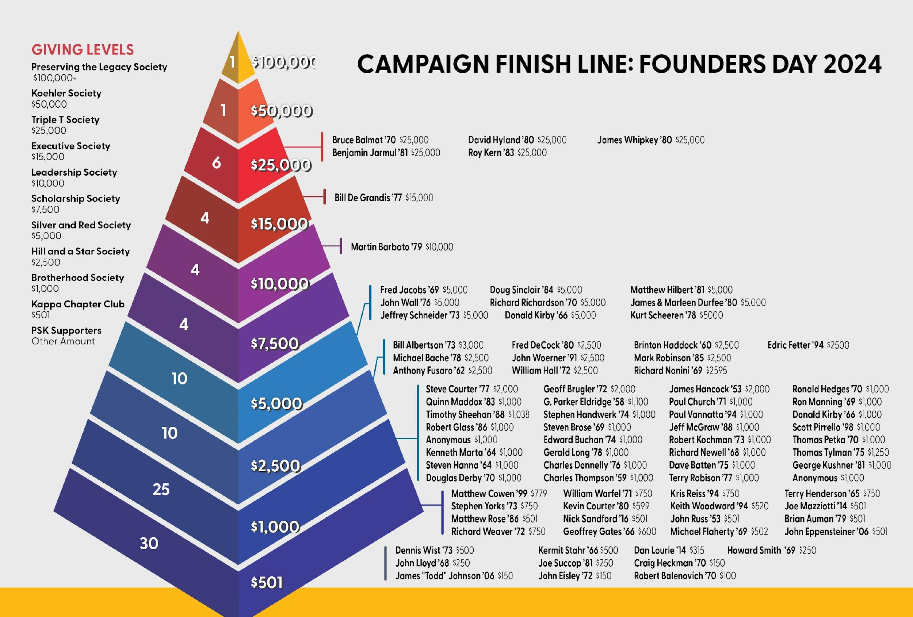
THANK YOU to our Damn Proud Supporters!

Slide 27

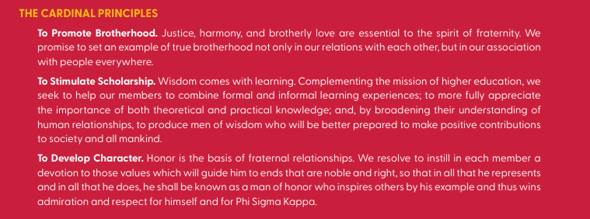
Capital Campaign Update
Thank You to Our Brothers!
To all the brothers who have pledged and donated to the Damn Proud Campaign, we extend our deepest gratitude. Your generosity is a testament to the enduring strength of our brotherhood and our shared commitment to preserving the legacy of Phi Sigma Kappa.
We are also proud to announce that we achieved 100% participation from our Board, showing our collective determination to strengthen our fraternity for all current and future brothers. Together, we are building a better future for Phi Sigma Kappa – one that honors our past, supports our present, and empowers the generations to come.
Thank you for being a vital part of this journey and for helping us achieve our shared vision for a brighter tomorrow. We couldn’t do it without you!
-Daniel Lourie, 2014

Slide 28
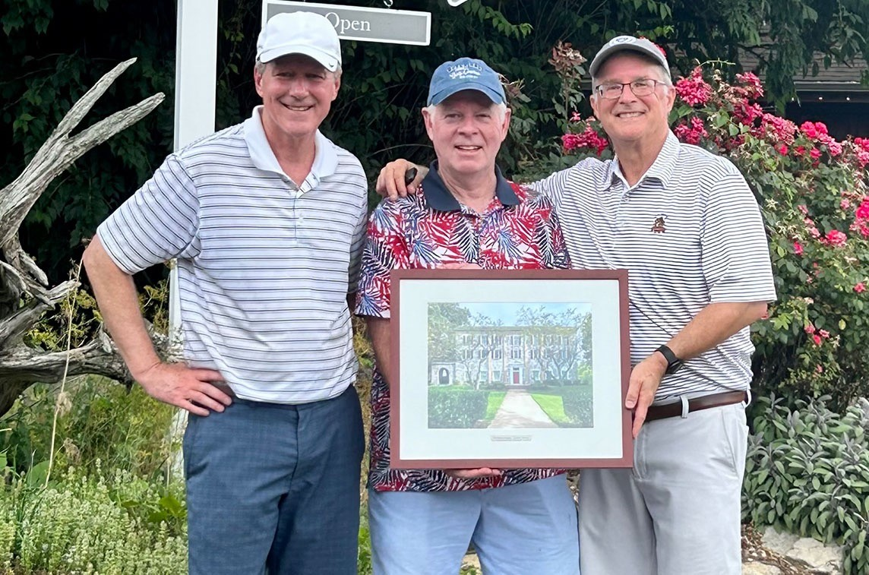
Please consider supporting the campaign
Pledges payable over 5 years
Every donor receives a beautiful framed lithograph of the House
PhiSigPSU.com/campaign

Slide 29
Q & A

Slide 30
Closing Comments
Help Us All Stay Connected:
Get your current email address, cell phone number, and mailing address information to Elevate (Emily O'Neill) at eoneill@elevateims.com.
Keep your Elevate Profile current.
Send notices of life changes (e.g., family, professional) to Elevate.
Volunteer:
Become an Advisor, help on a Special Project, and/or join the Board.
Bring your Time, Talent, and/or Treasure. You are needed. Give something.

